Slide 1
The single-cell transcriptome landscape of human digestive system
Feng Tian
1/23/2019
Notes:
大家好，今天我总结一下目前的一些进展。

Slide 2
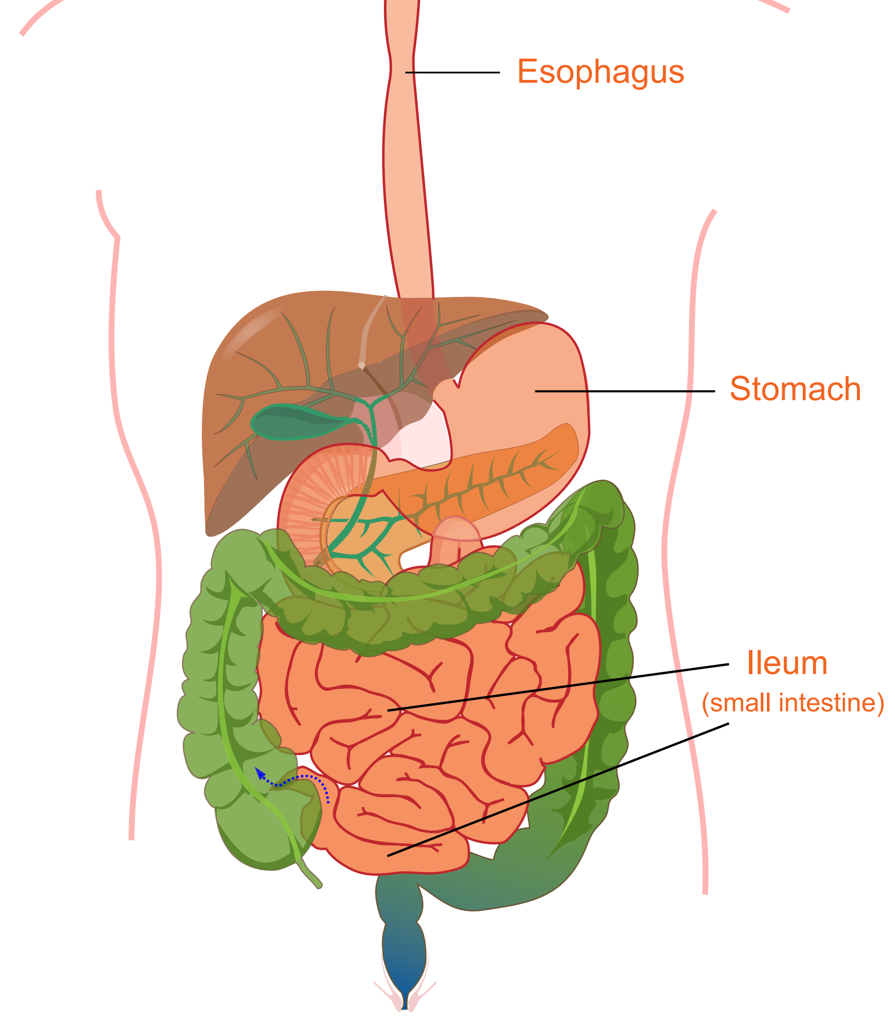
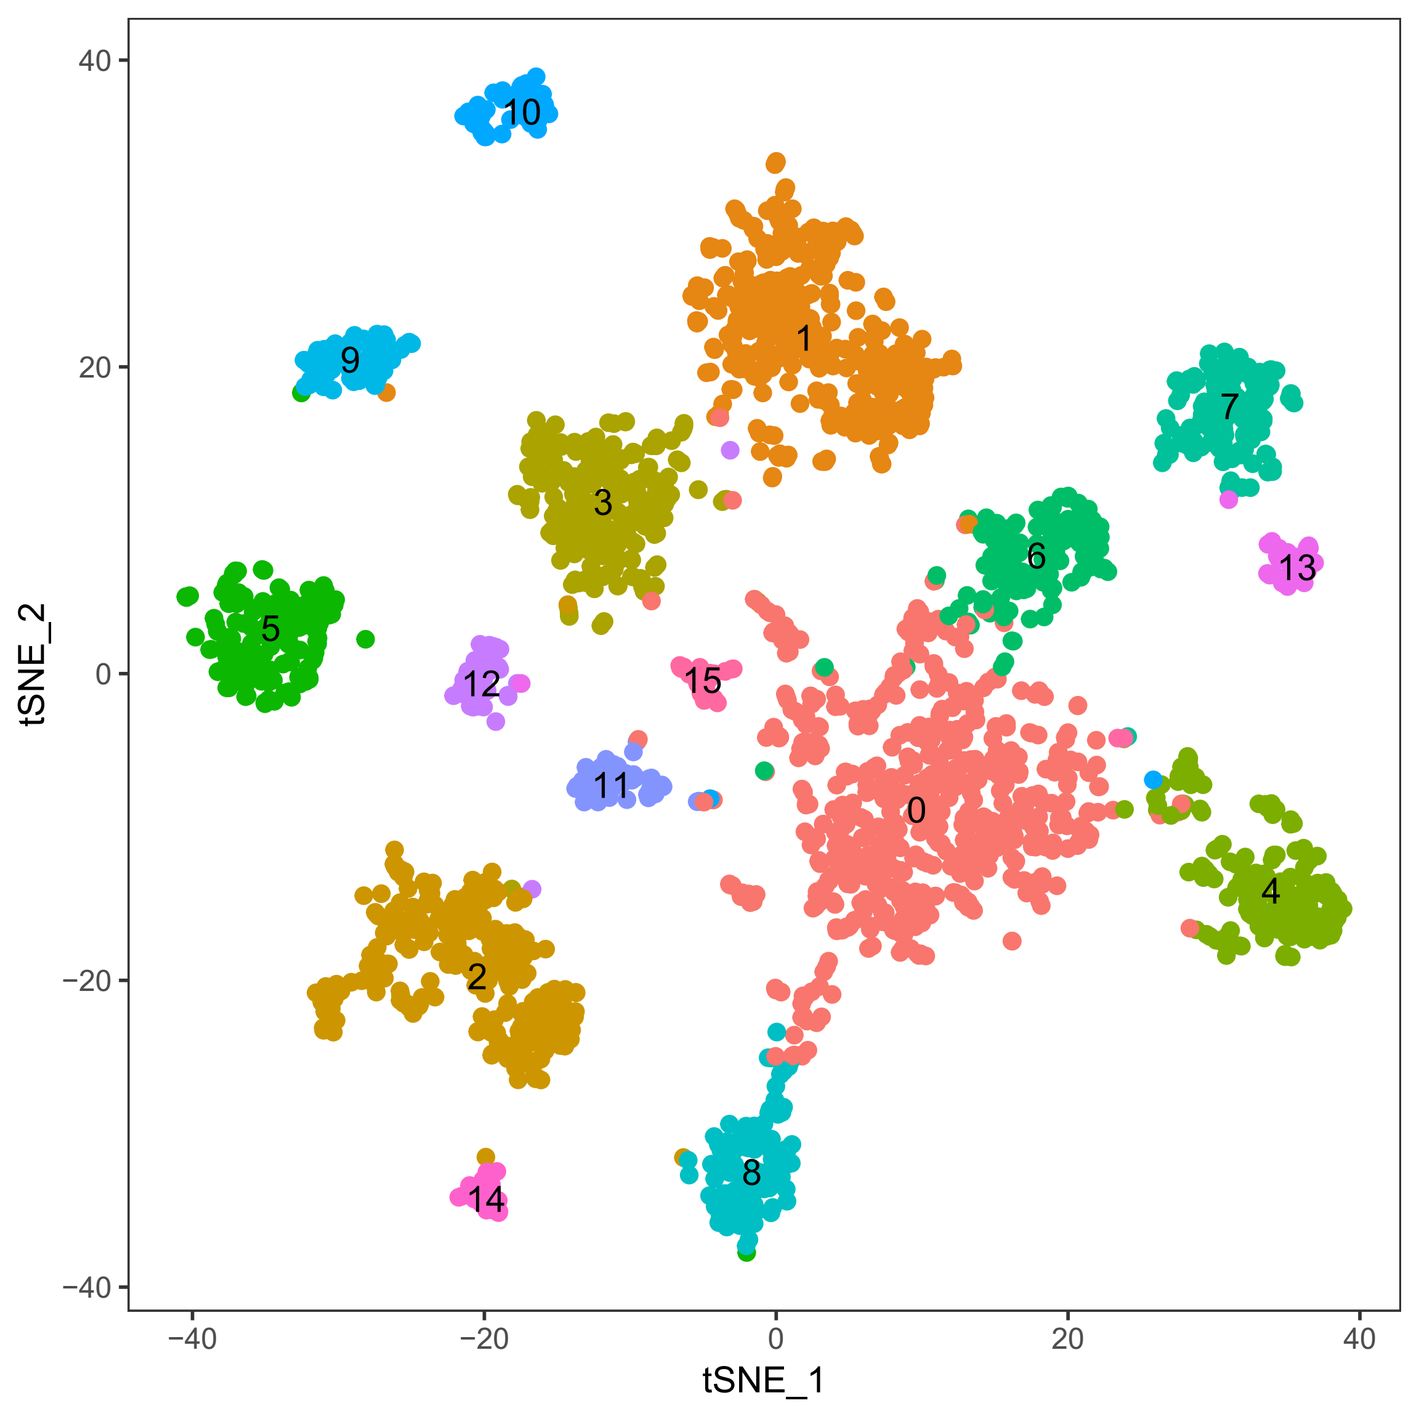
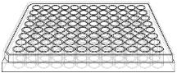

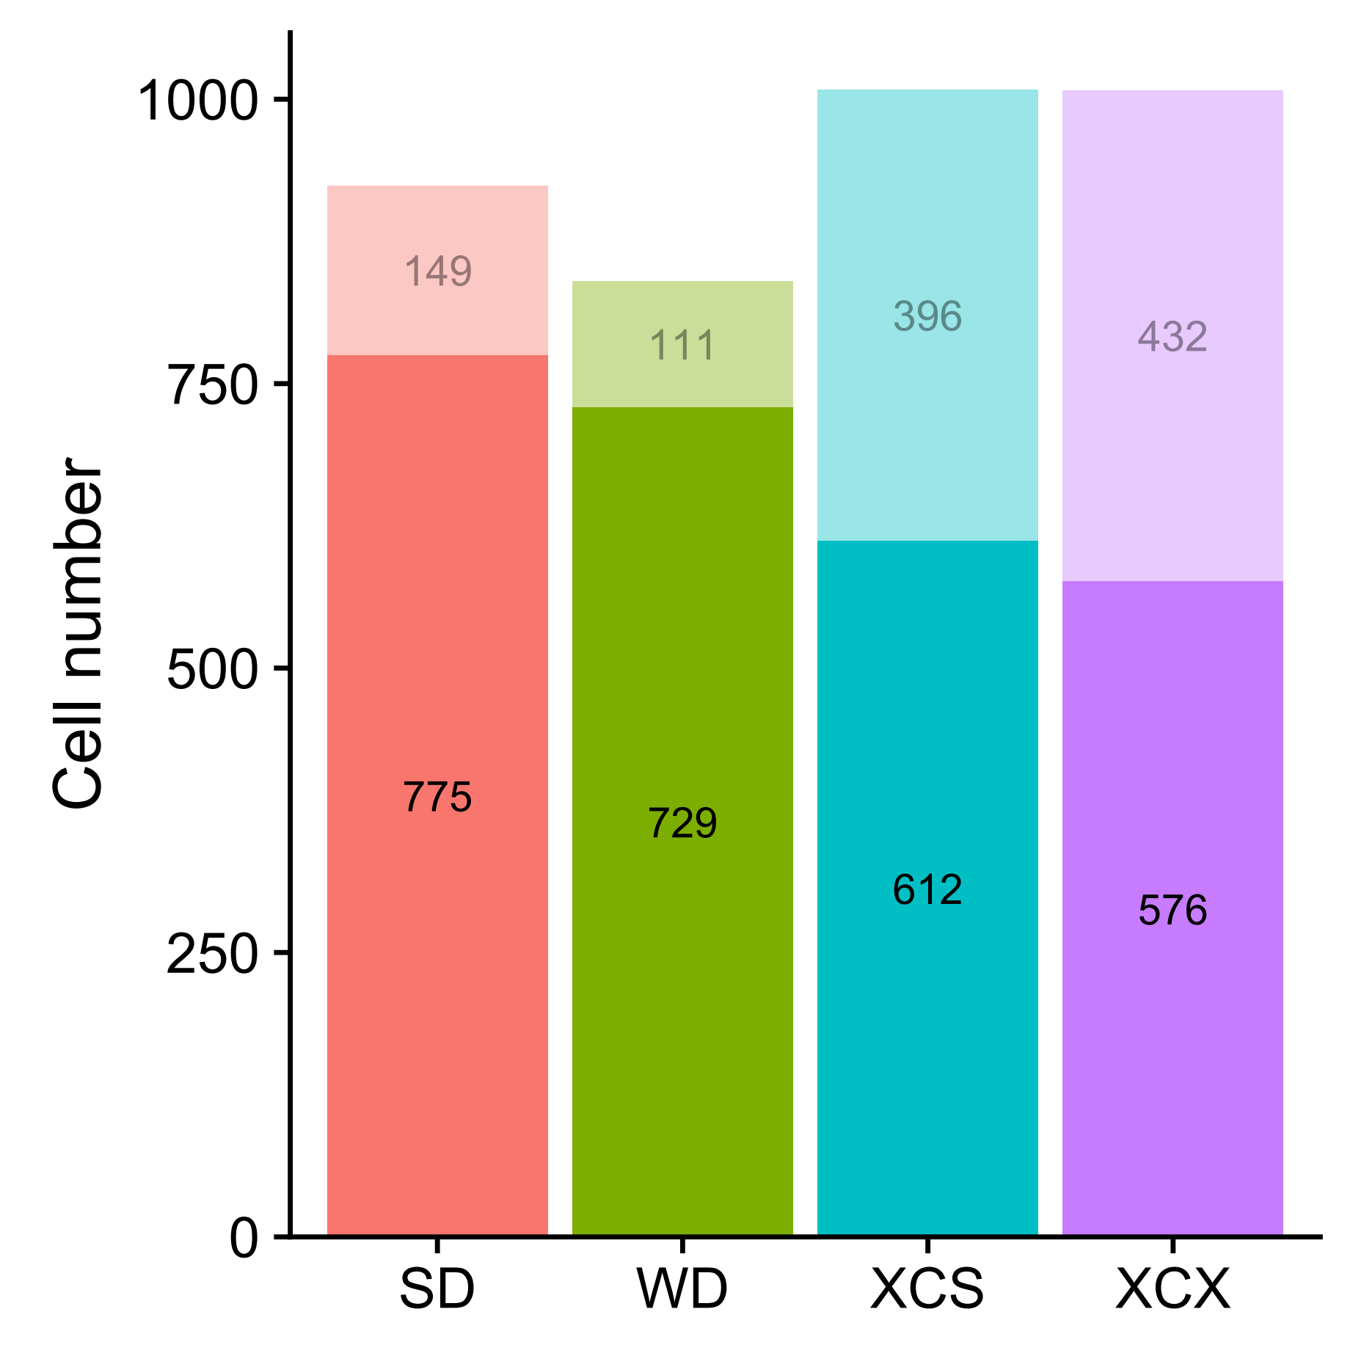
Single-cell sequencing for the human digestive system
SD
WD
S
XC
X
71.21% (2,692 / 3,780) of cells passed the filtering process.
The diagram was modified from Wikipedia.
Notes:
Figure tissues:
Figure 96-well plate:
Figure NGS: https://coursesandconferences.wellcomegenomecampus.org/our-events/next-generation-sequencing-2019/

Slide 3
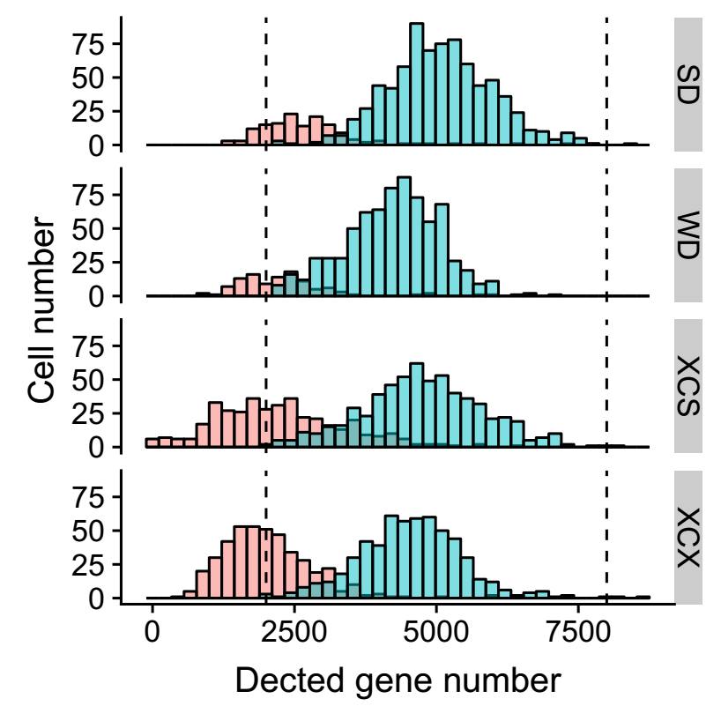
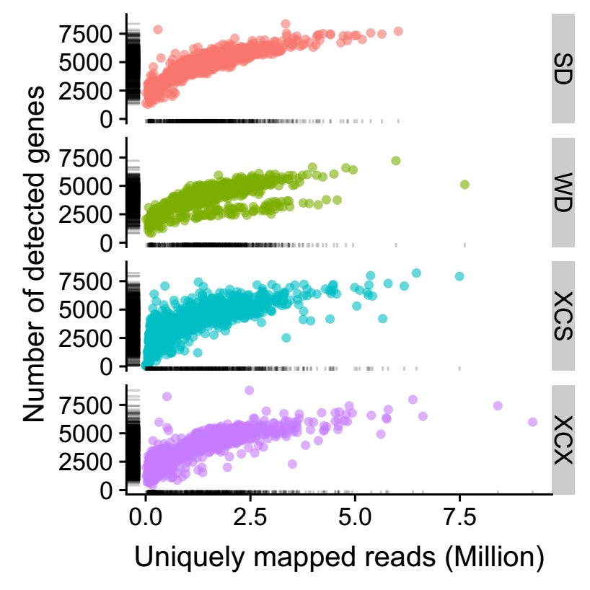
Single-cell sequencing for the human digestive system
Summary after filtering | Average | Median
Clean reads number (Million) | 2.1 | 1.91
Gene number | 4,655.36 | 4,648
UMI number | 18,907.96 | 17,180

Slide 4
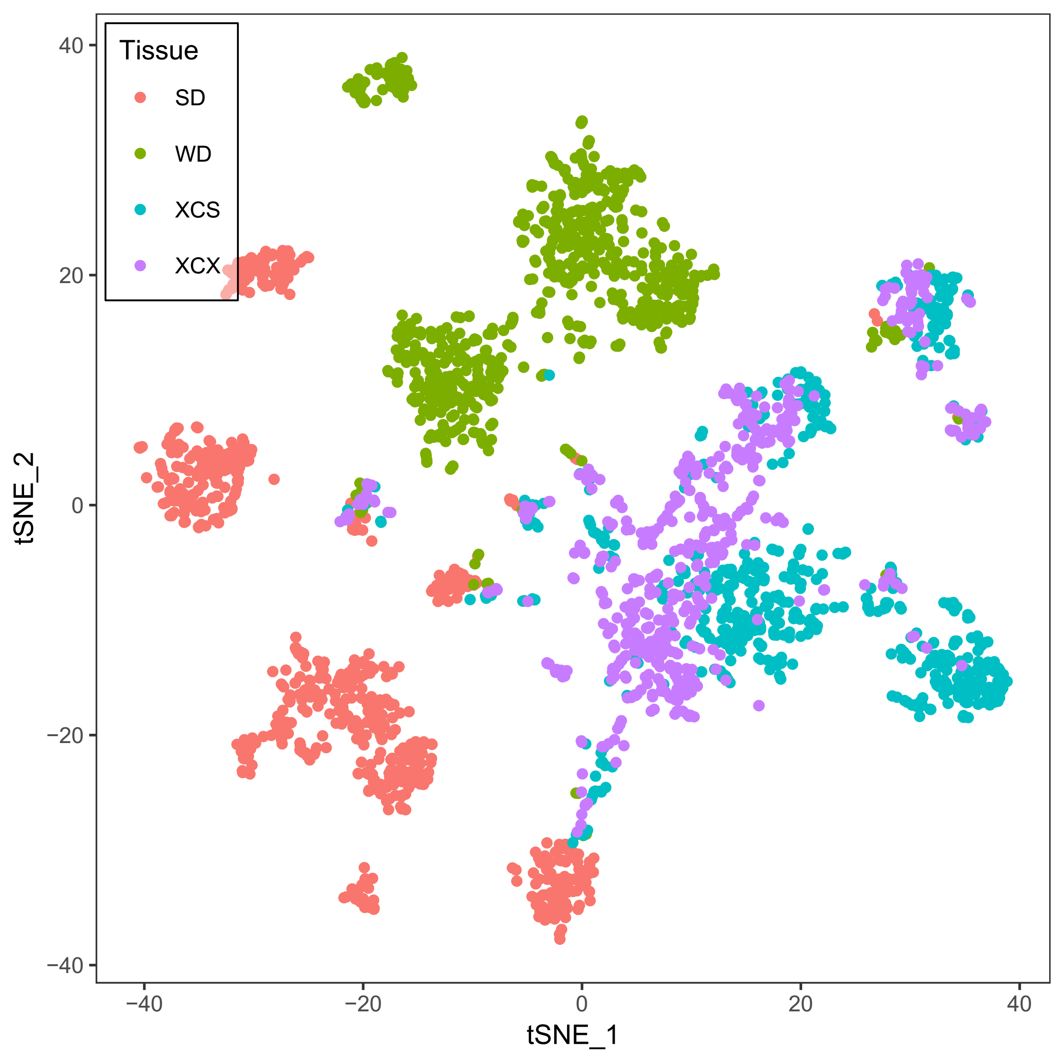
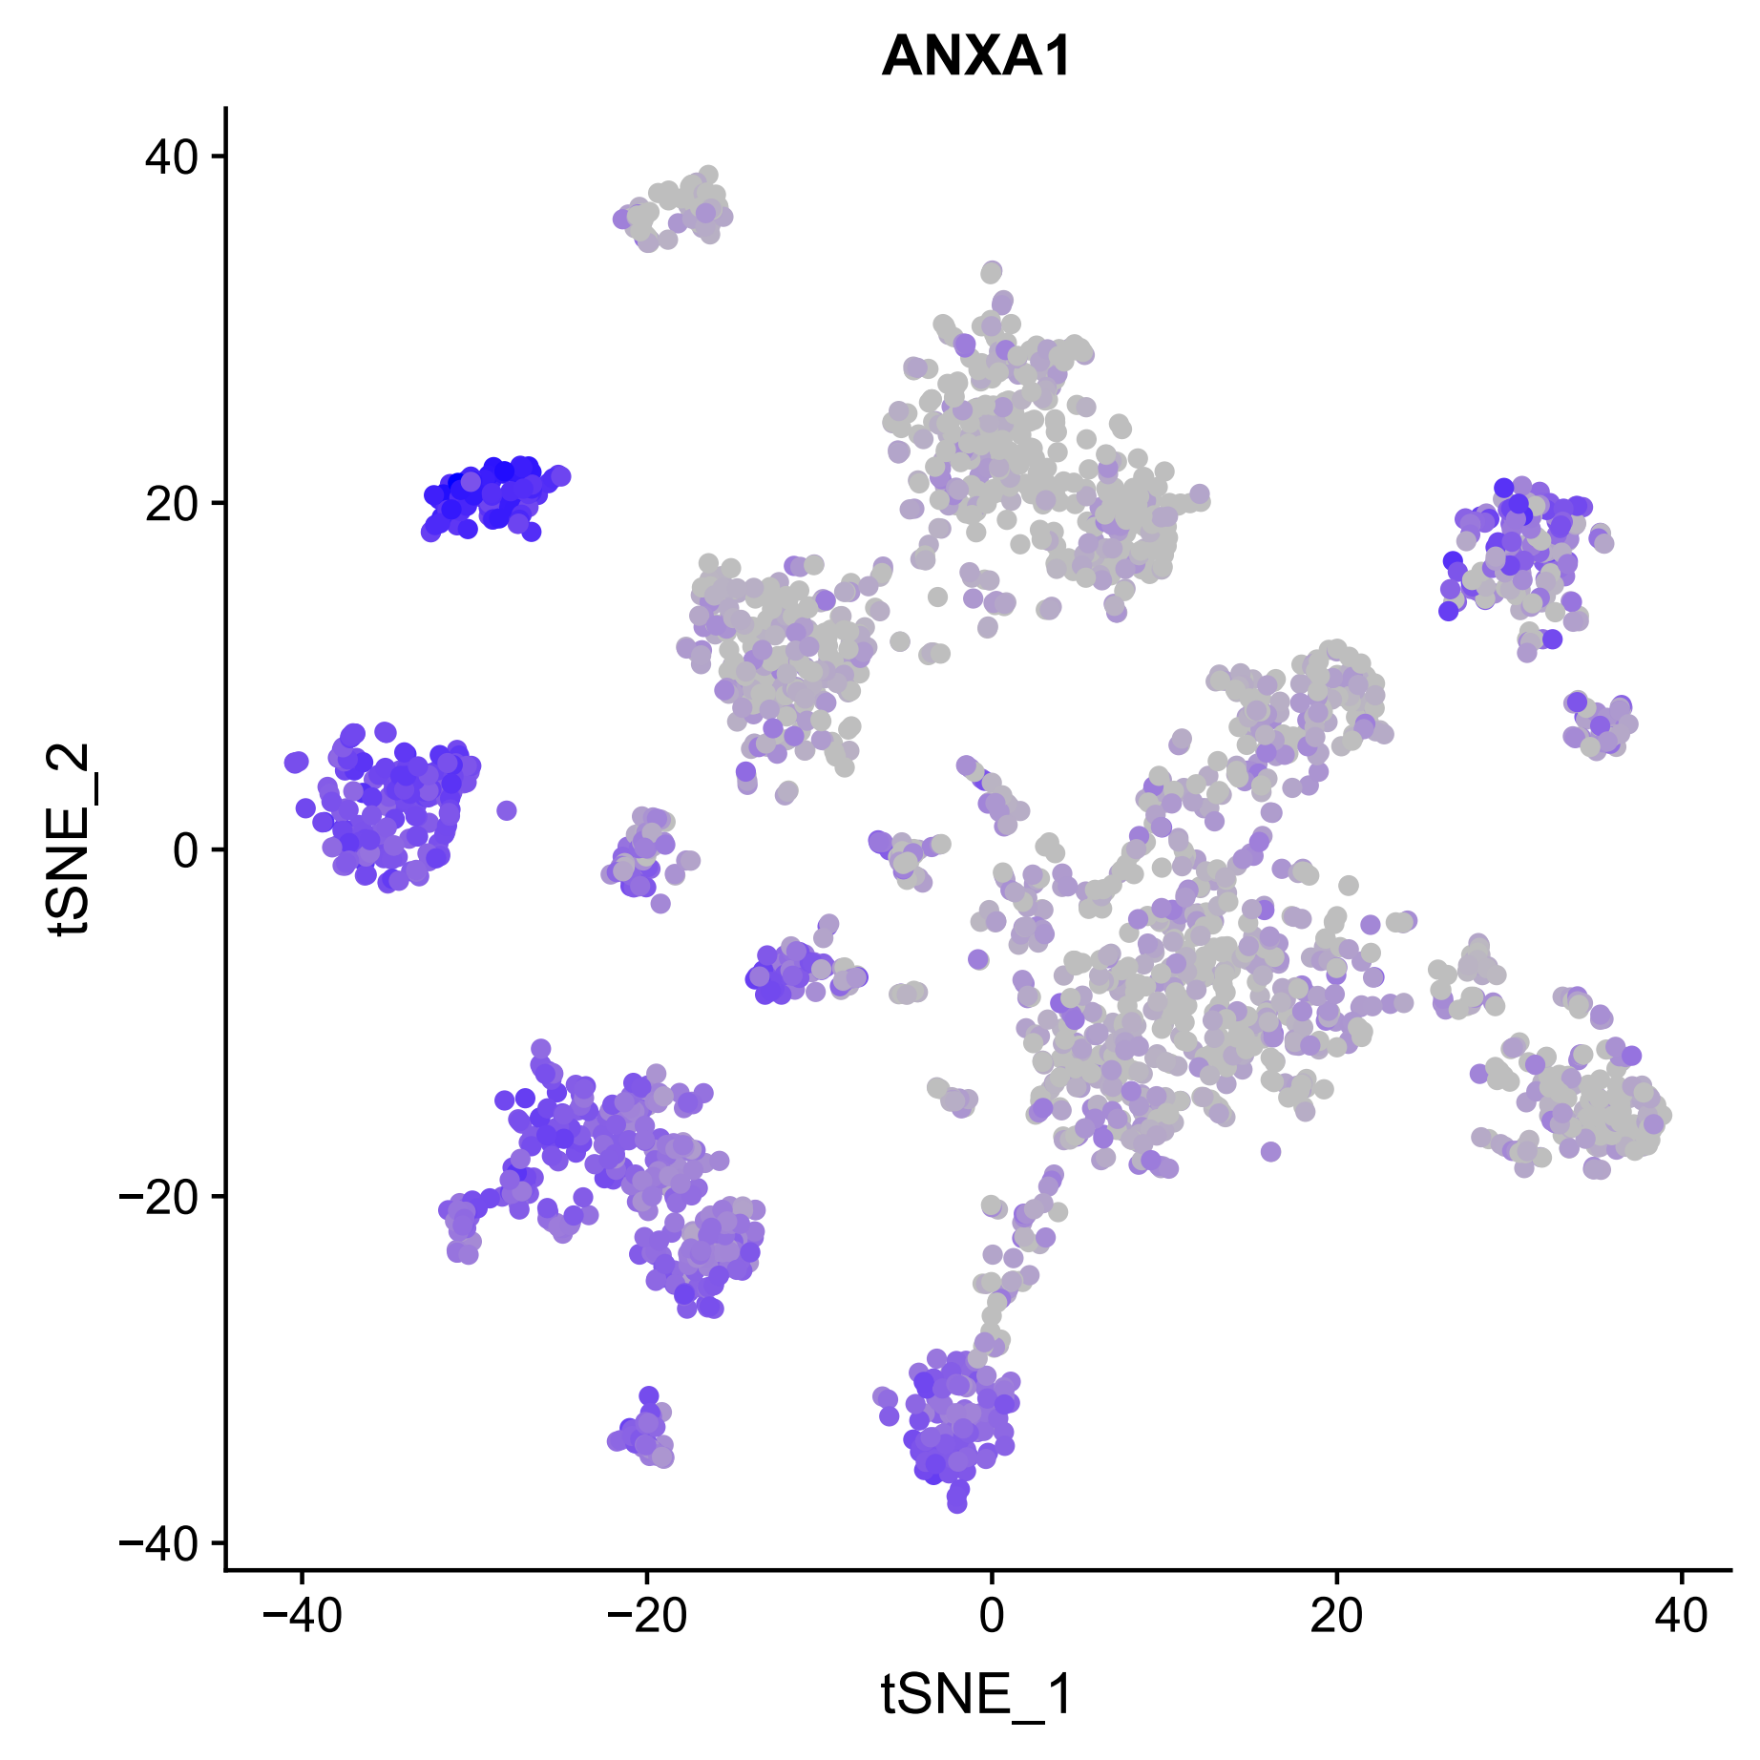
The overview of the digestive system
The result showed distinct pattern in different tissues.
There are 16 main cell types for 2,692 cells.

Slide 5
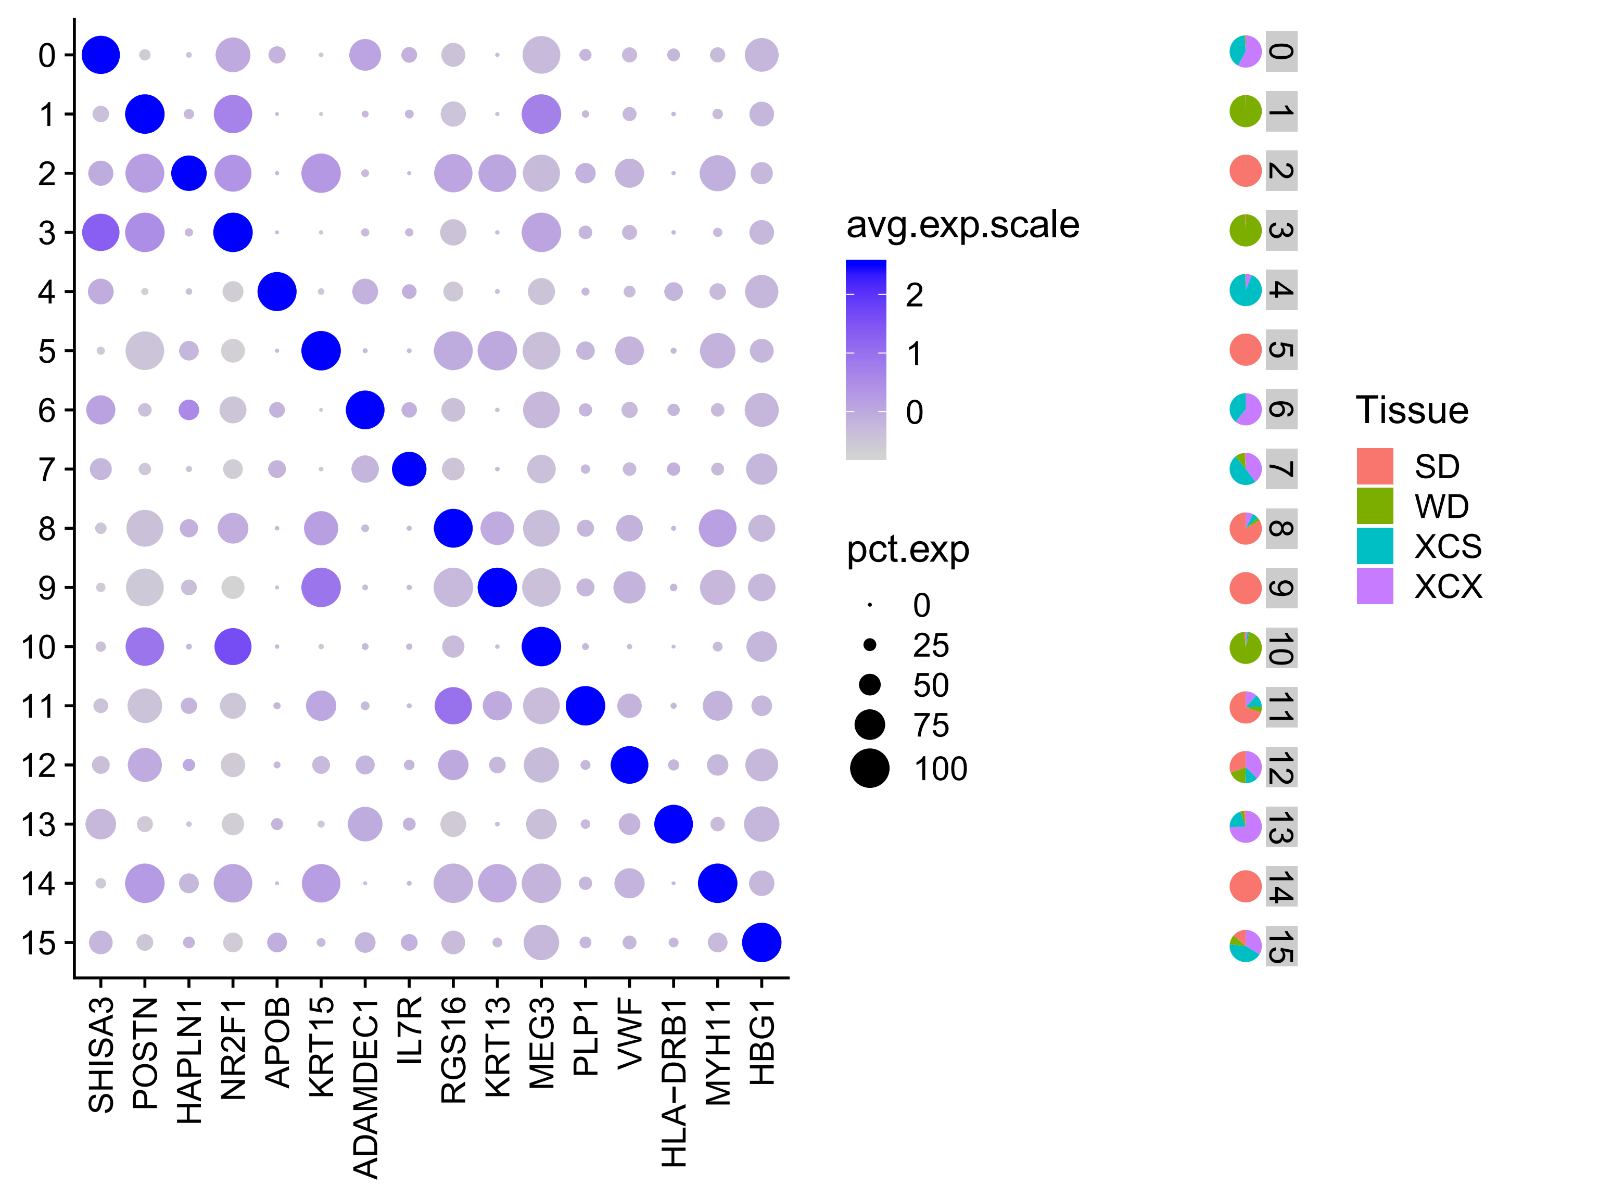
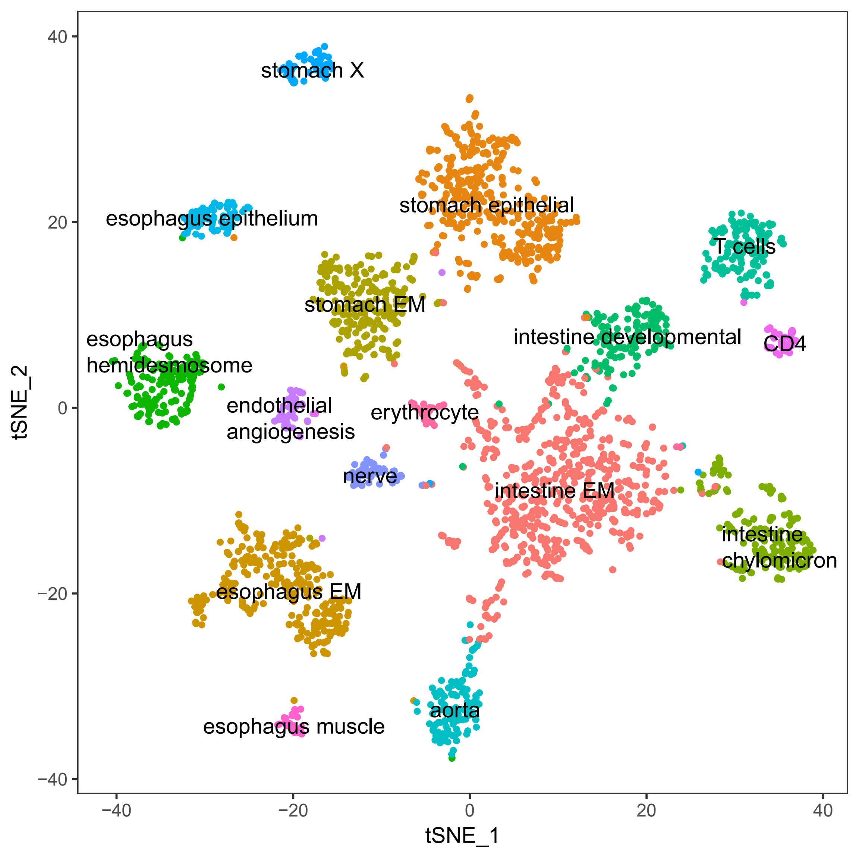
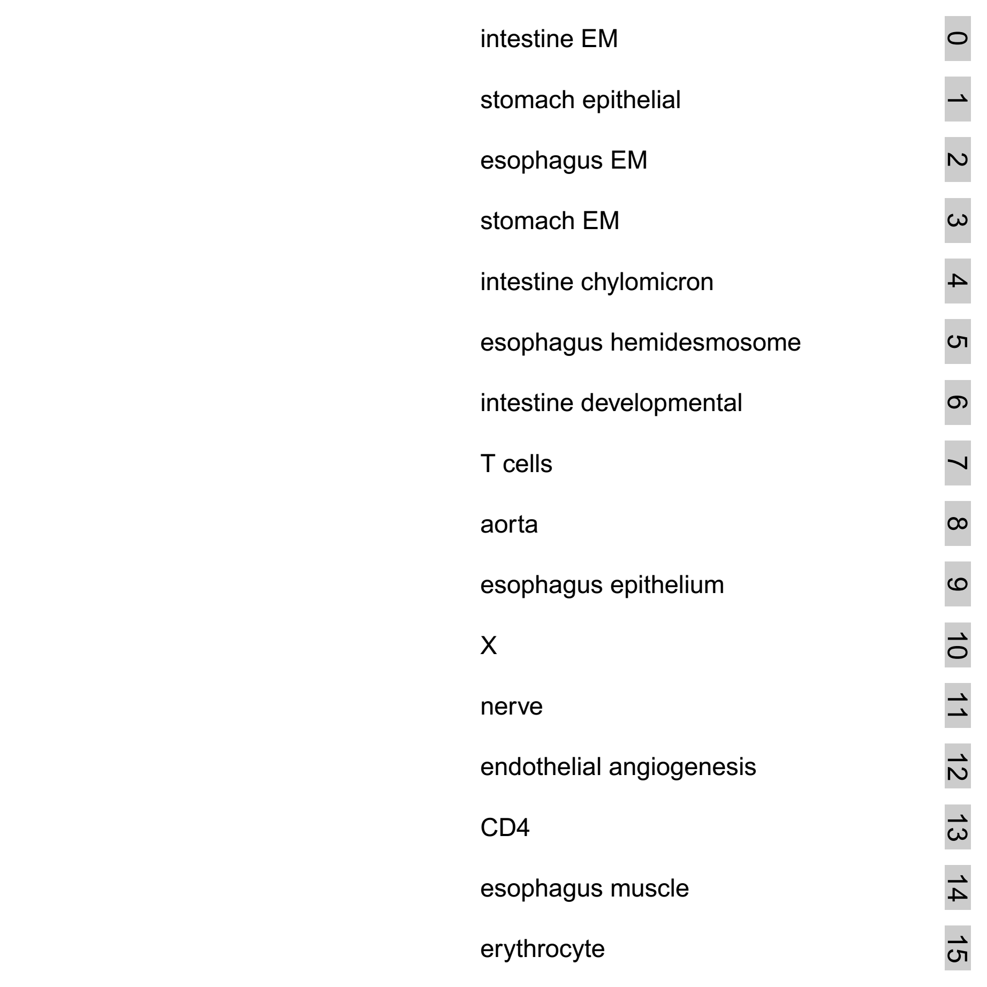
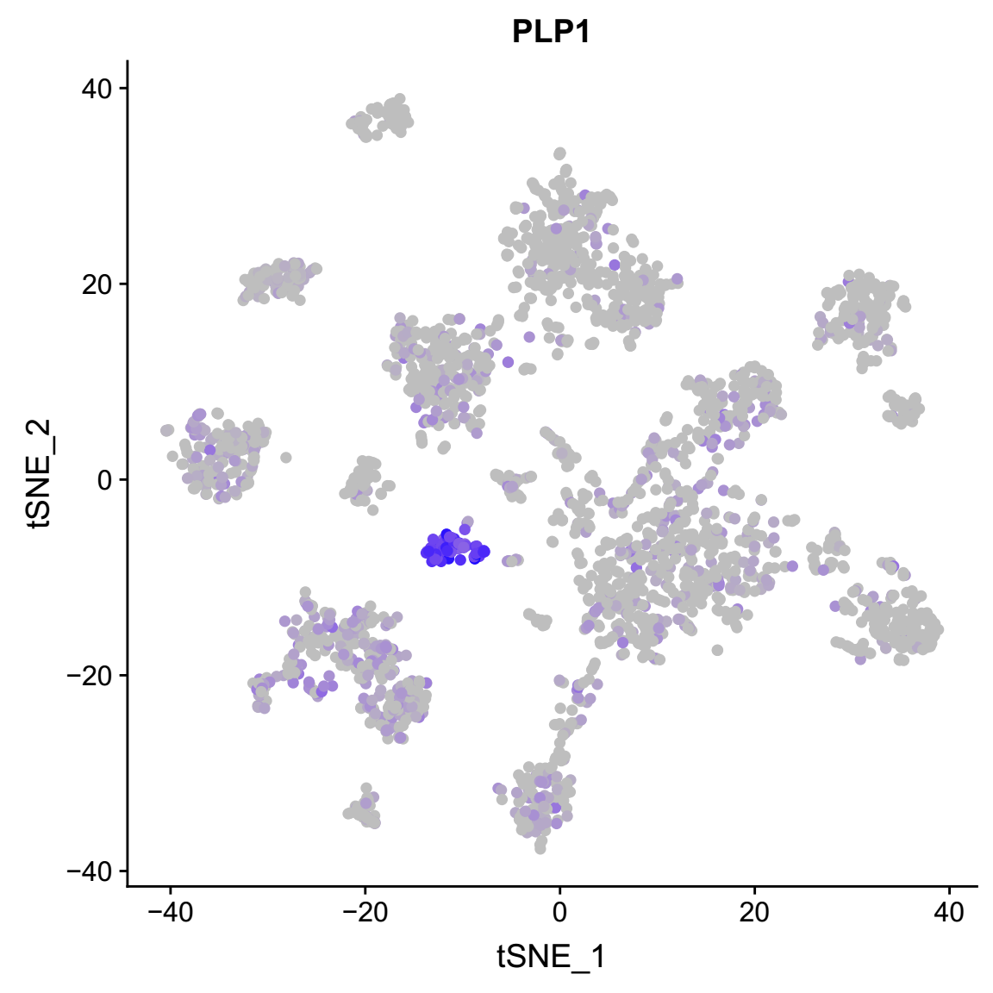
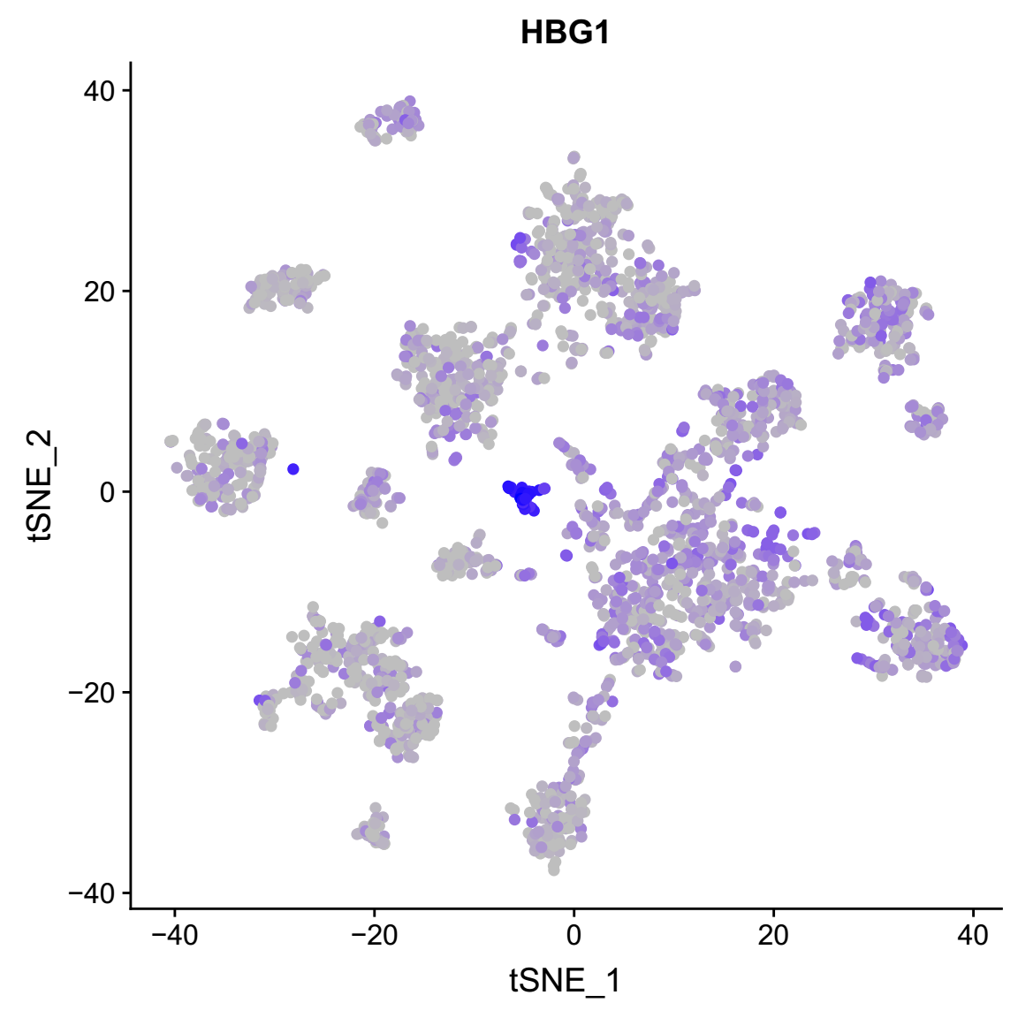
The overview of the digestive system
The cell fraction across tissues vary across cell clusters.
Annotate cell clusters by marker genes and GO enrichment analysis.

Slide 6
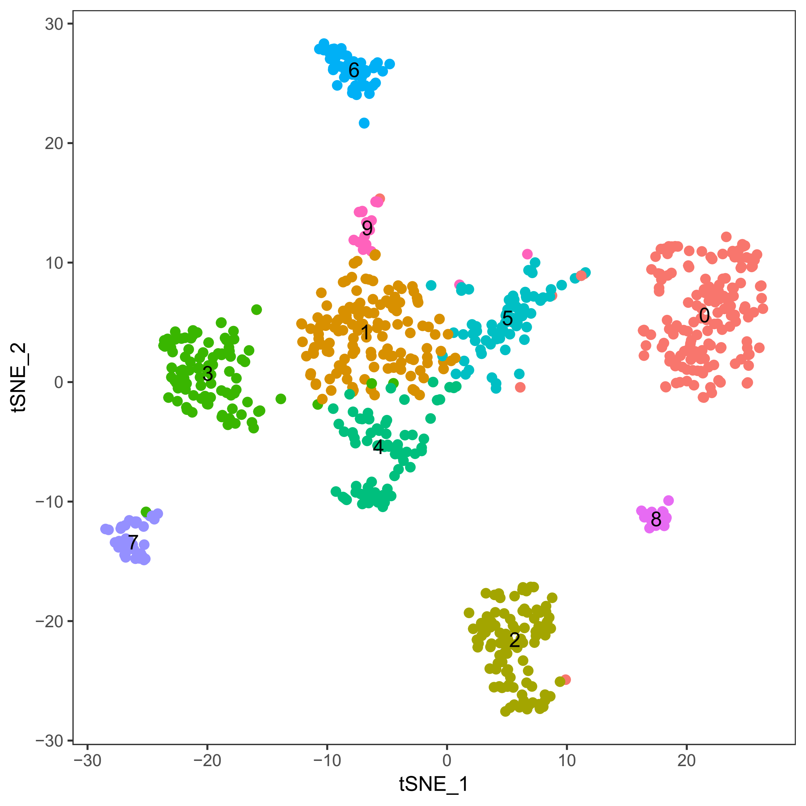
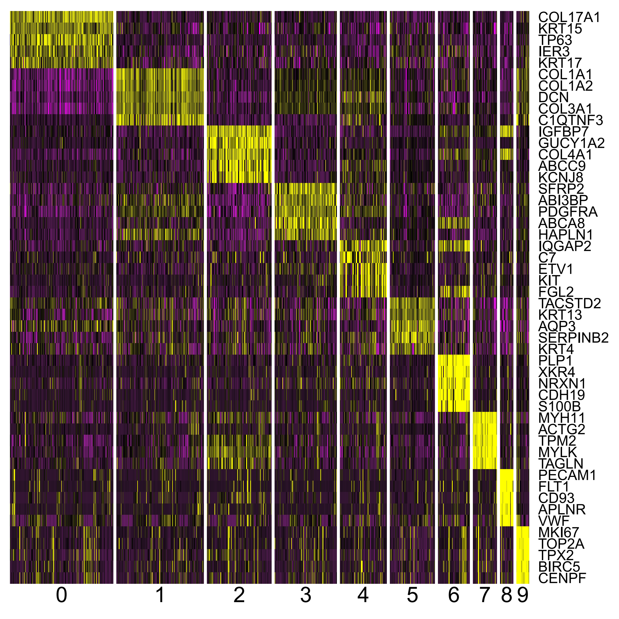
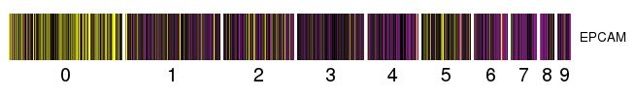
Cell type identification of esophagus
There are 10 cell types for 775 cells.

Slide 7
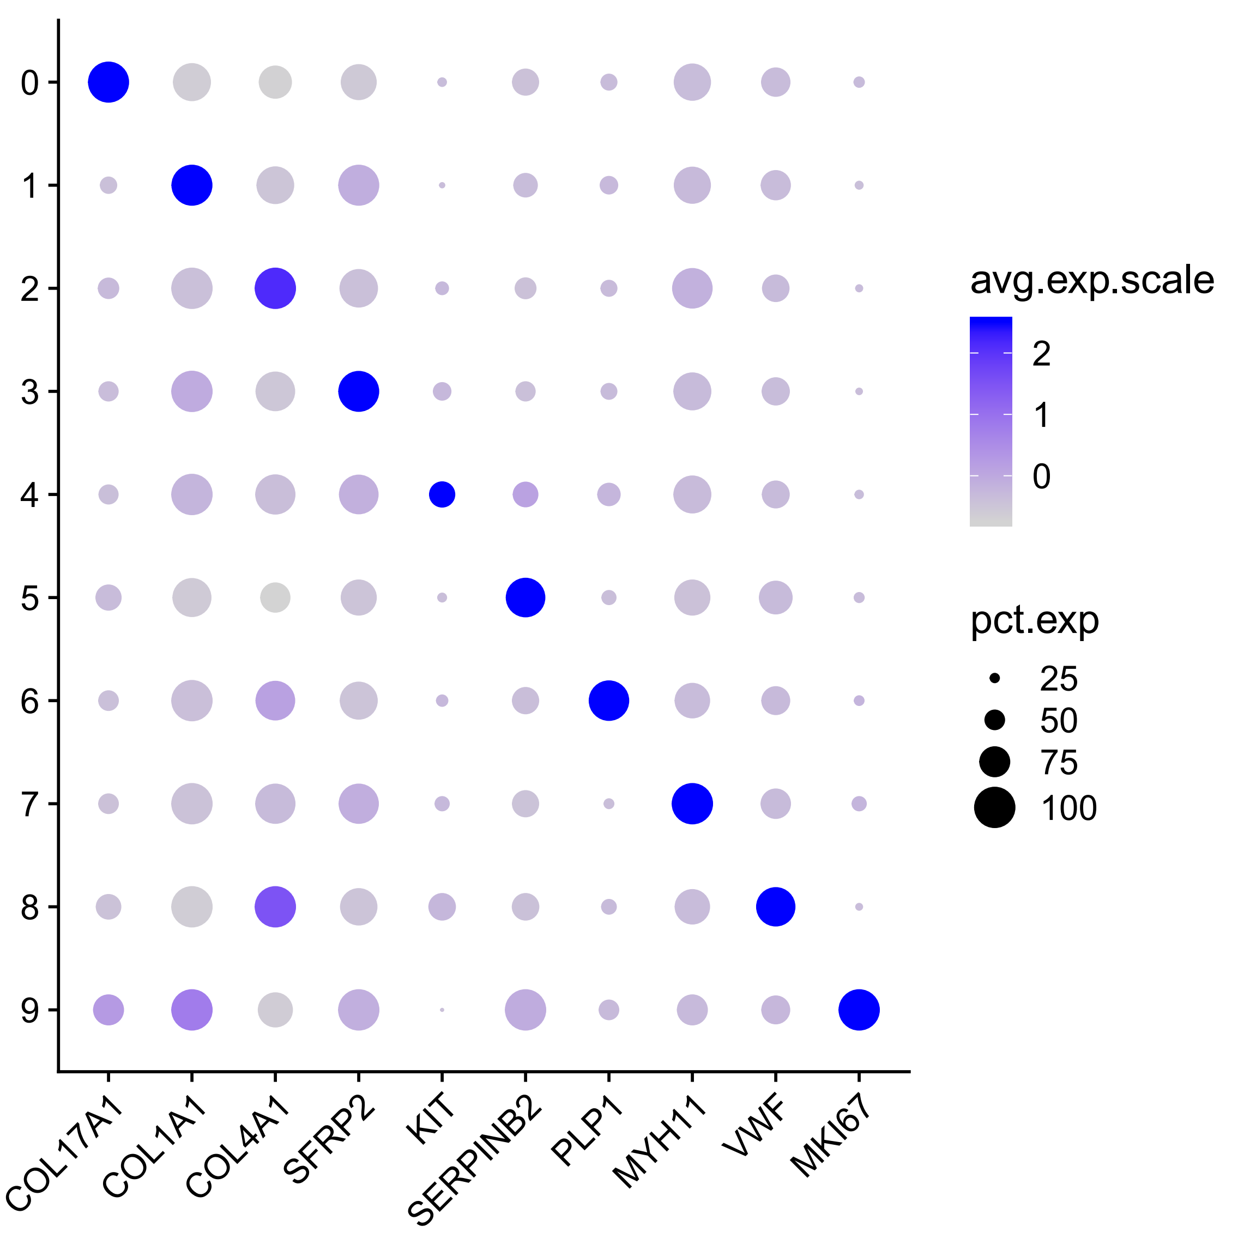
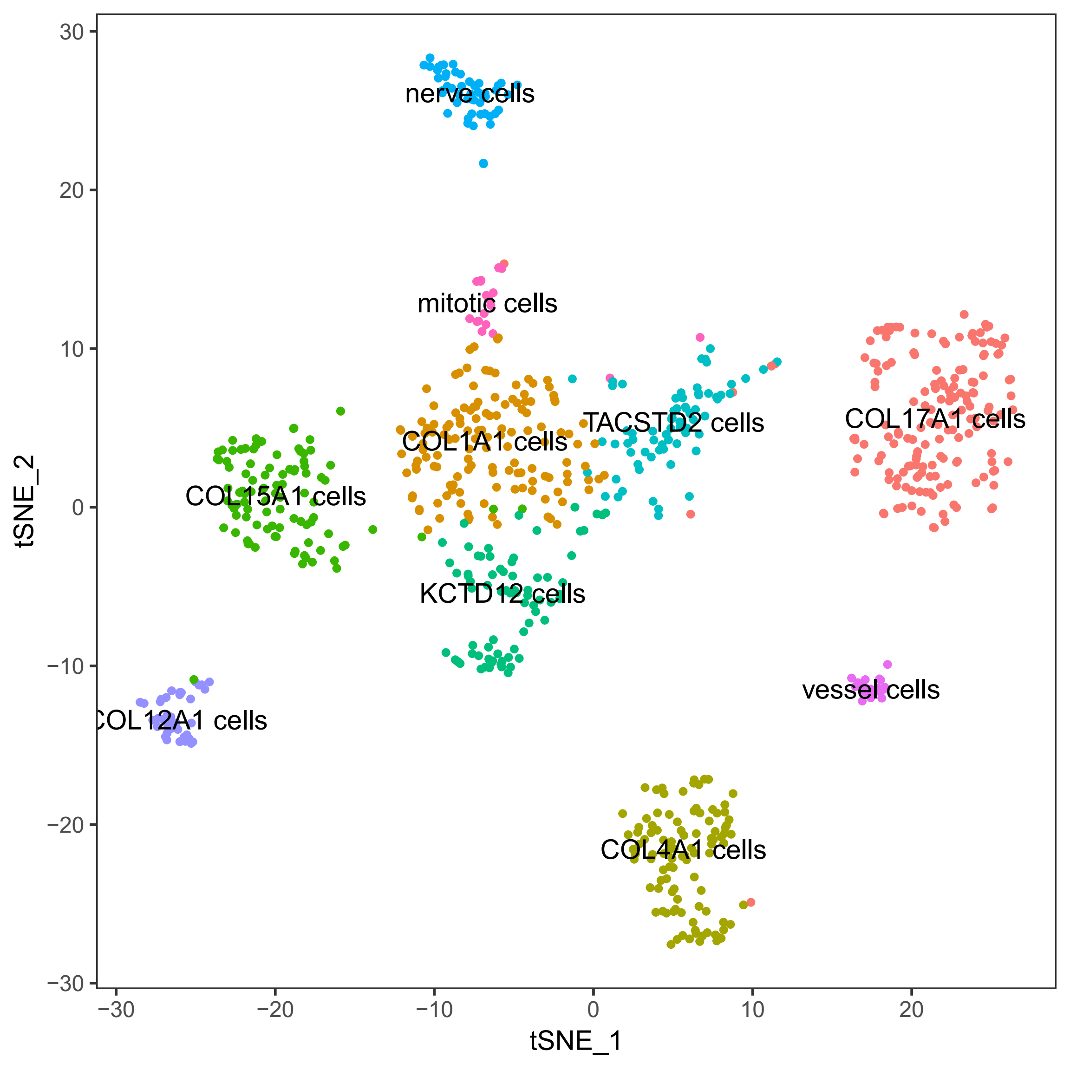
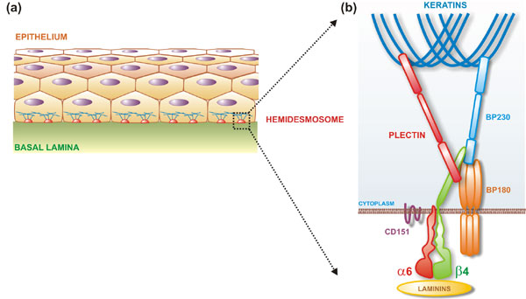
Cell type identification of esophagus
For example: COL17A1 (BP180) can produce Collagen XVII
A structural component of hemidesmosomes (半桥粒)
Overexpressed in skin and esophagus - Mucosa
The chart is downloaded from https://sites.google.com/site/epidermbullosa/pathogenesis.

Slide 8
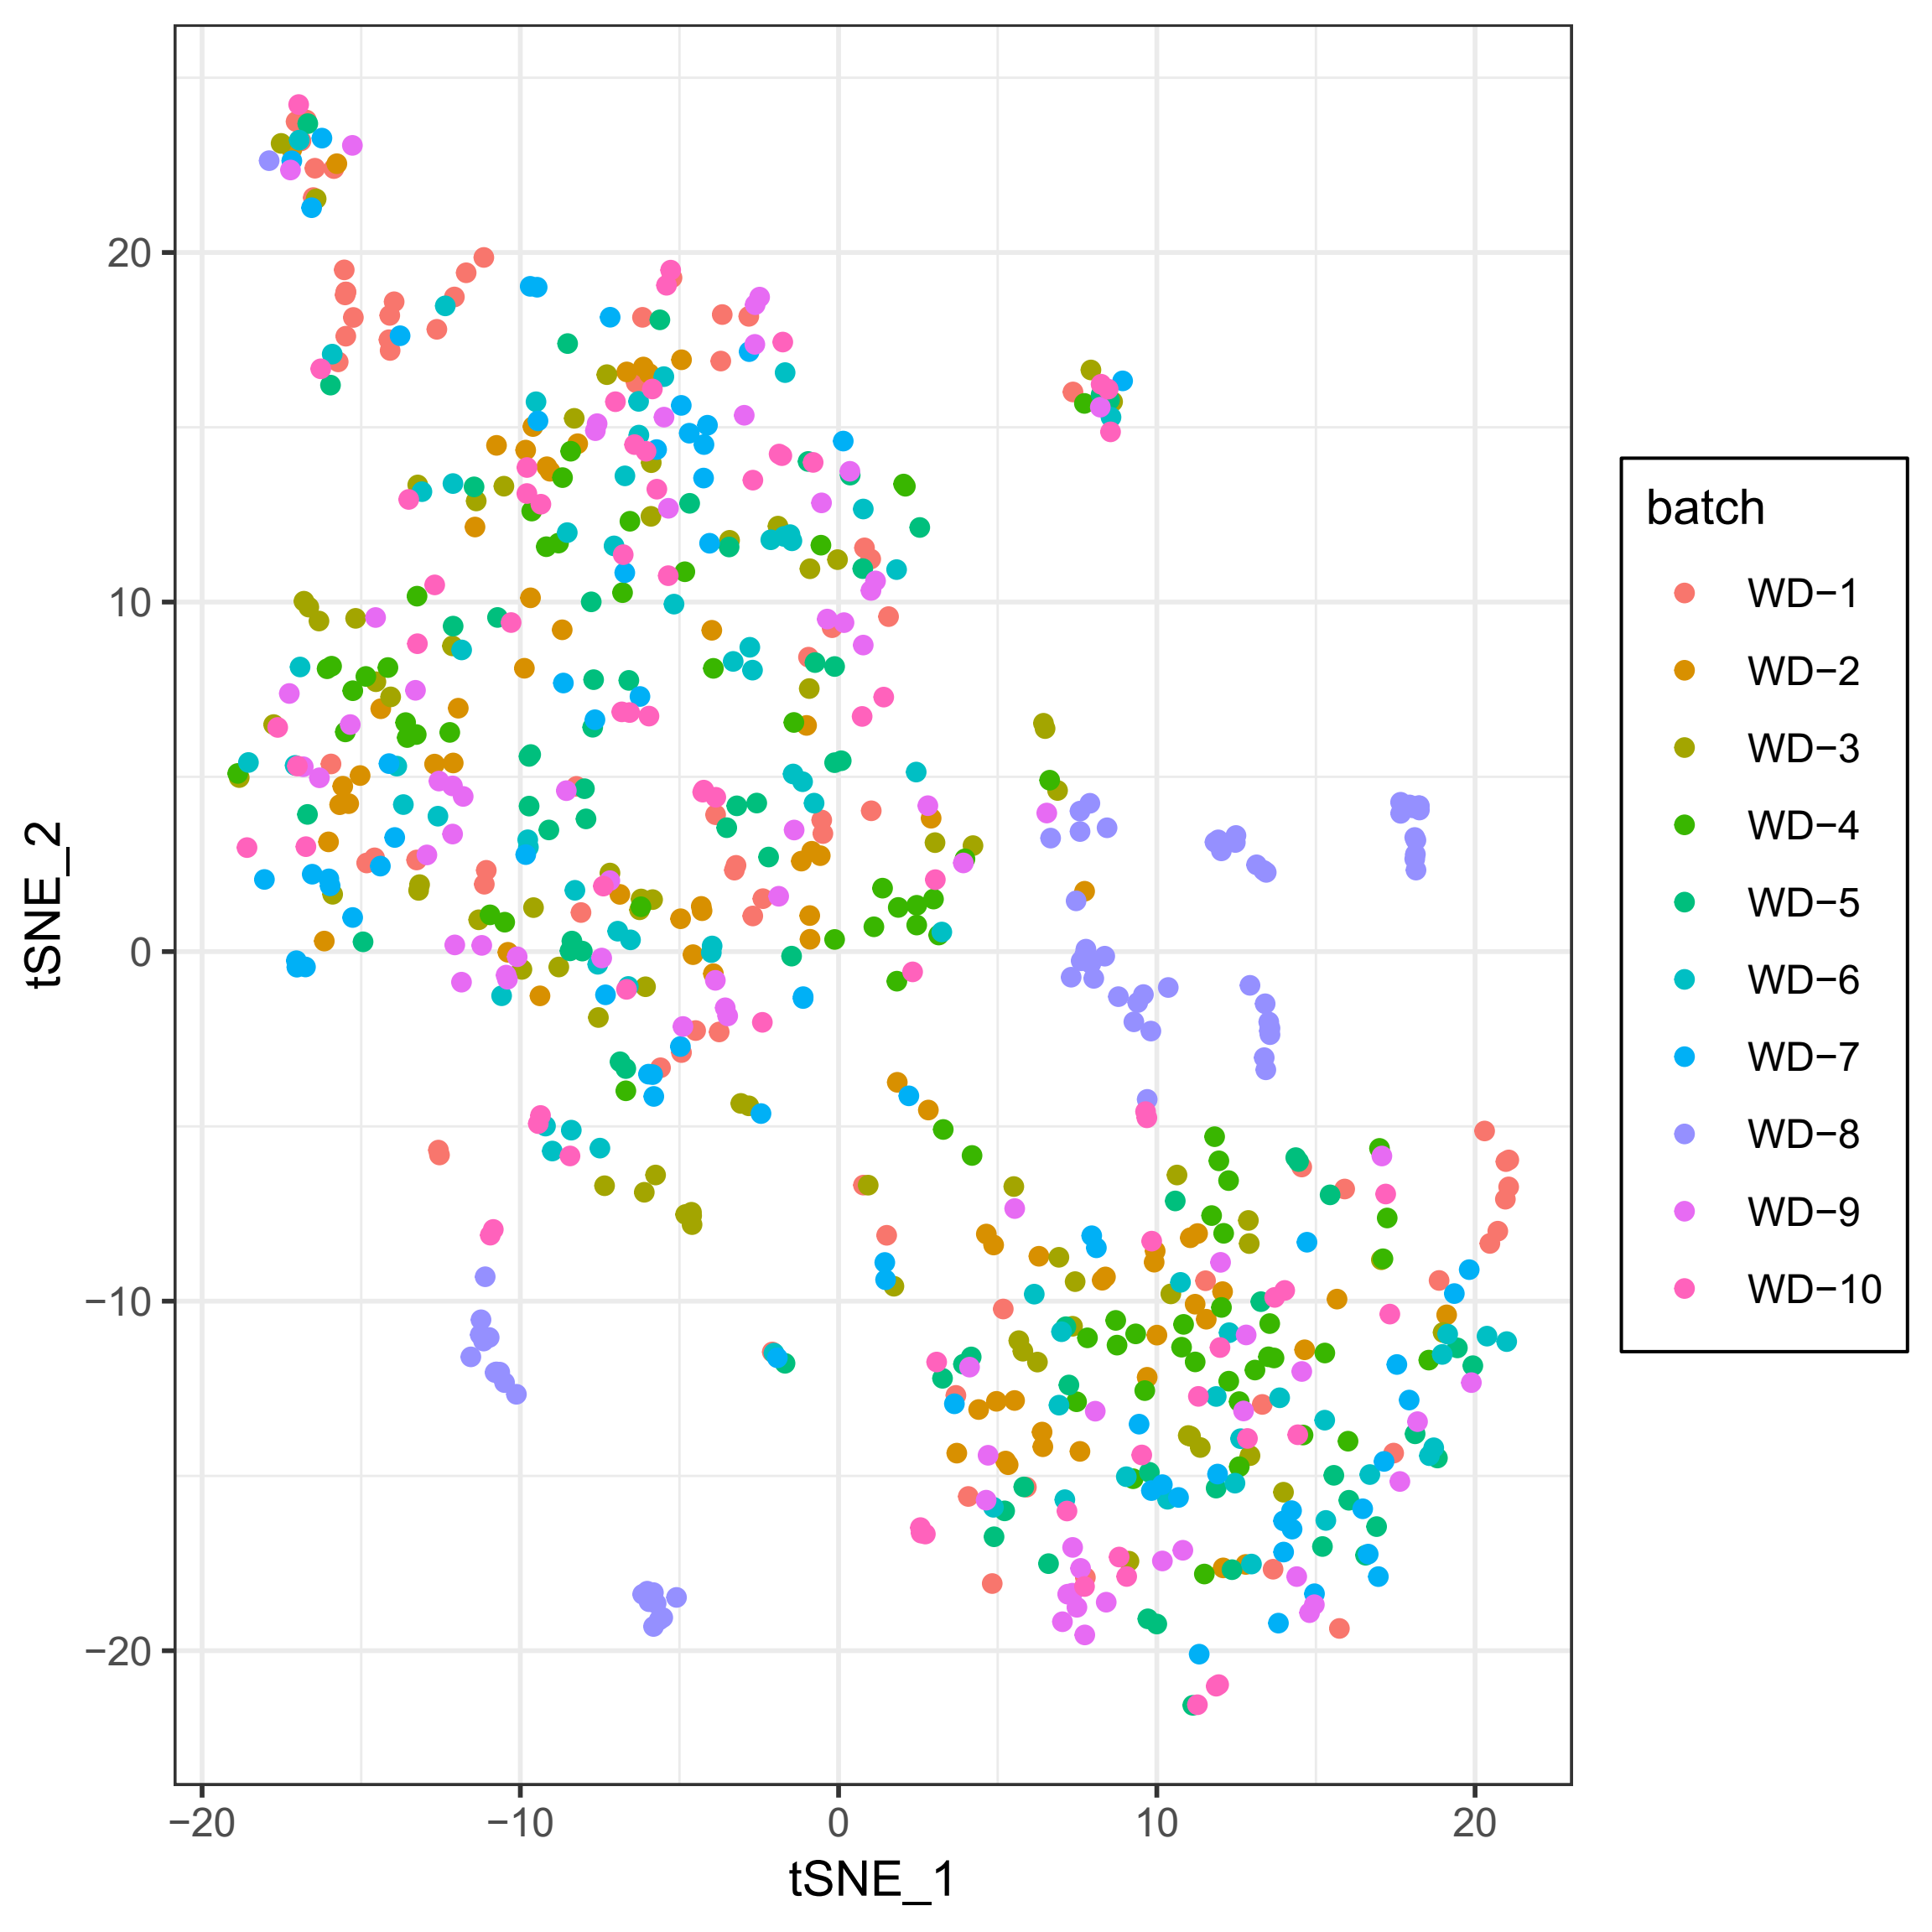
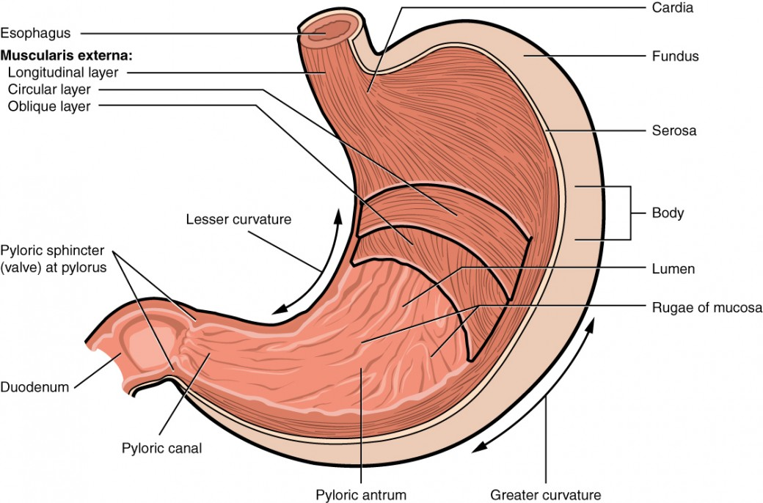
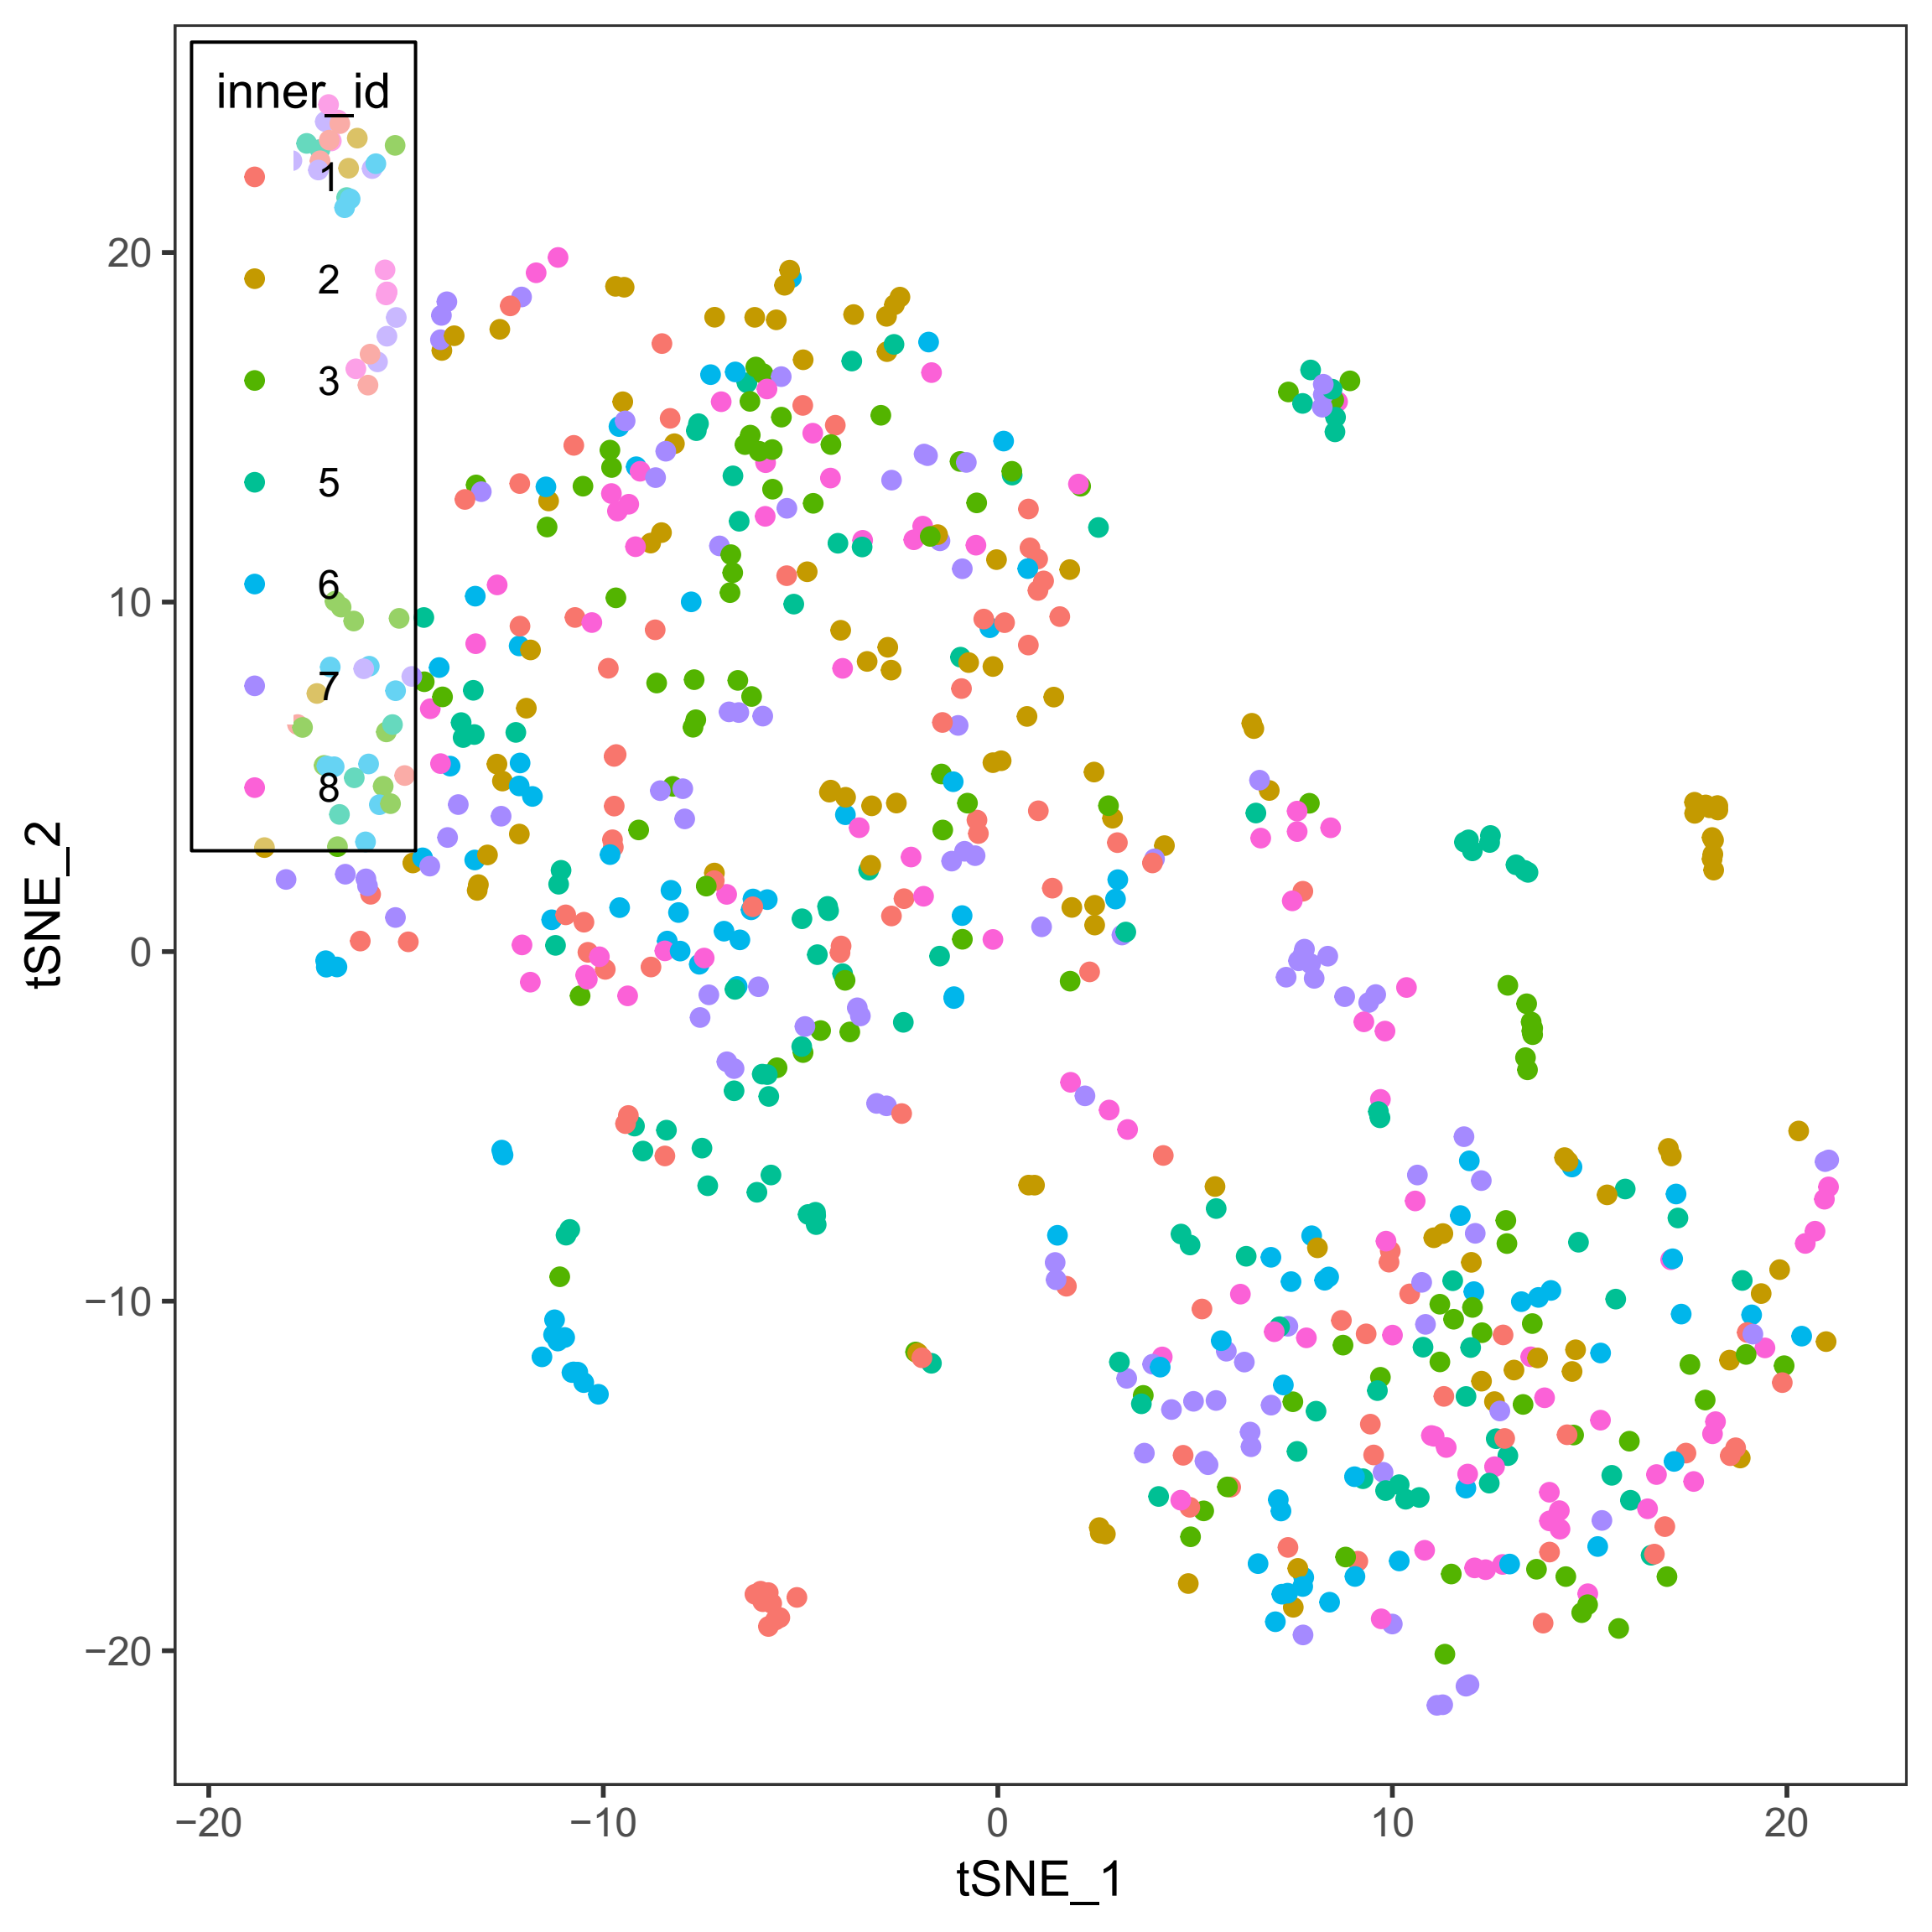
Cell type identification of stomach (fundus)
Abnormal plate ID: WD-8.
The cells in WD-8 showed distinct distribution on TSNE-plot.
The cells in WD-8 were also grouped by inner barcodes.
The chart is downloaded from https://courses.lumenlearning.com.

Slide 9
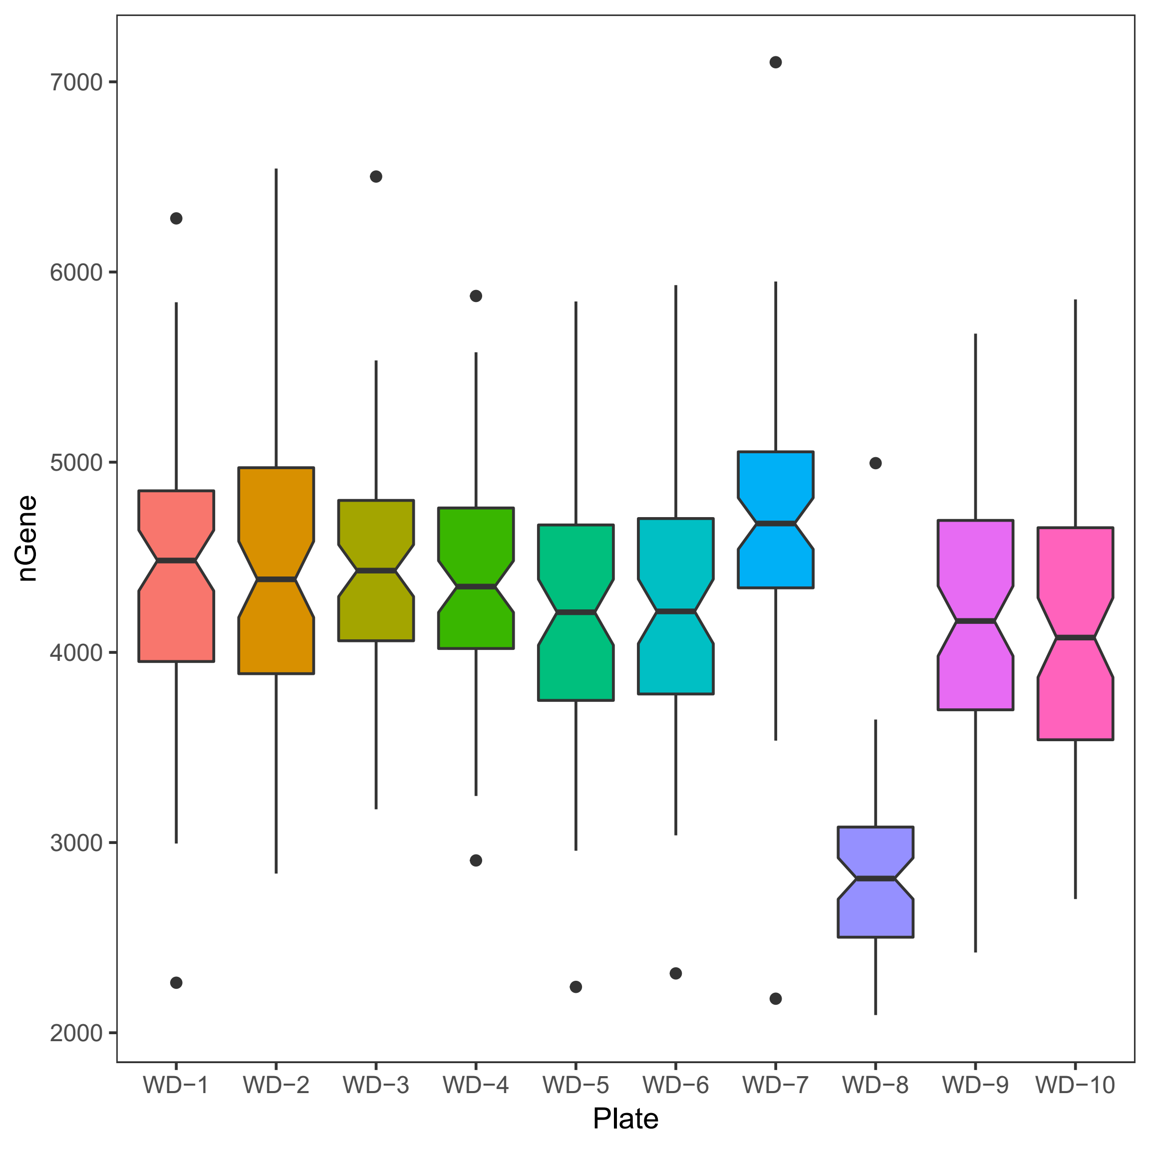
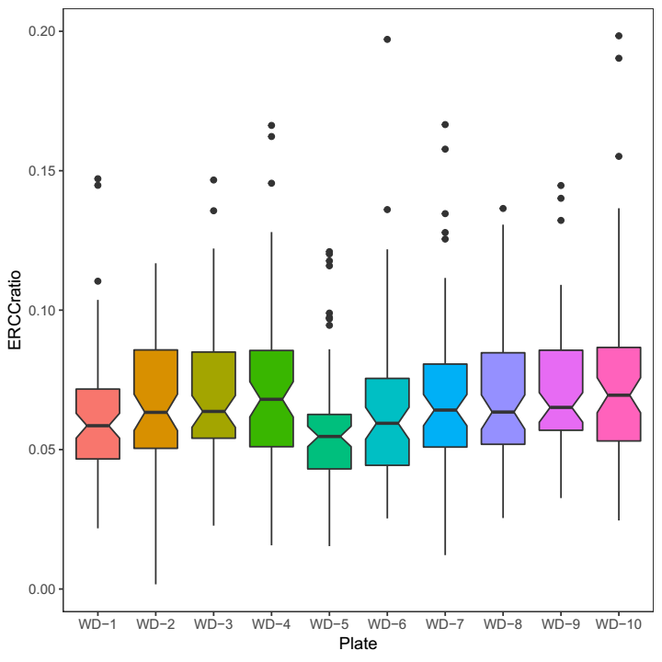

Cell type identification of stomach (fundus)
The cells in WD-8:
Showed less detected gene number.
But showed similar expression levels of mitochondrial genes.

Slide 10
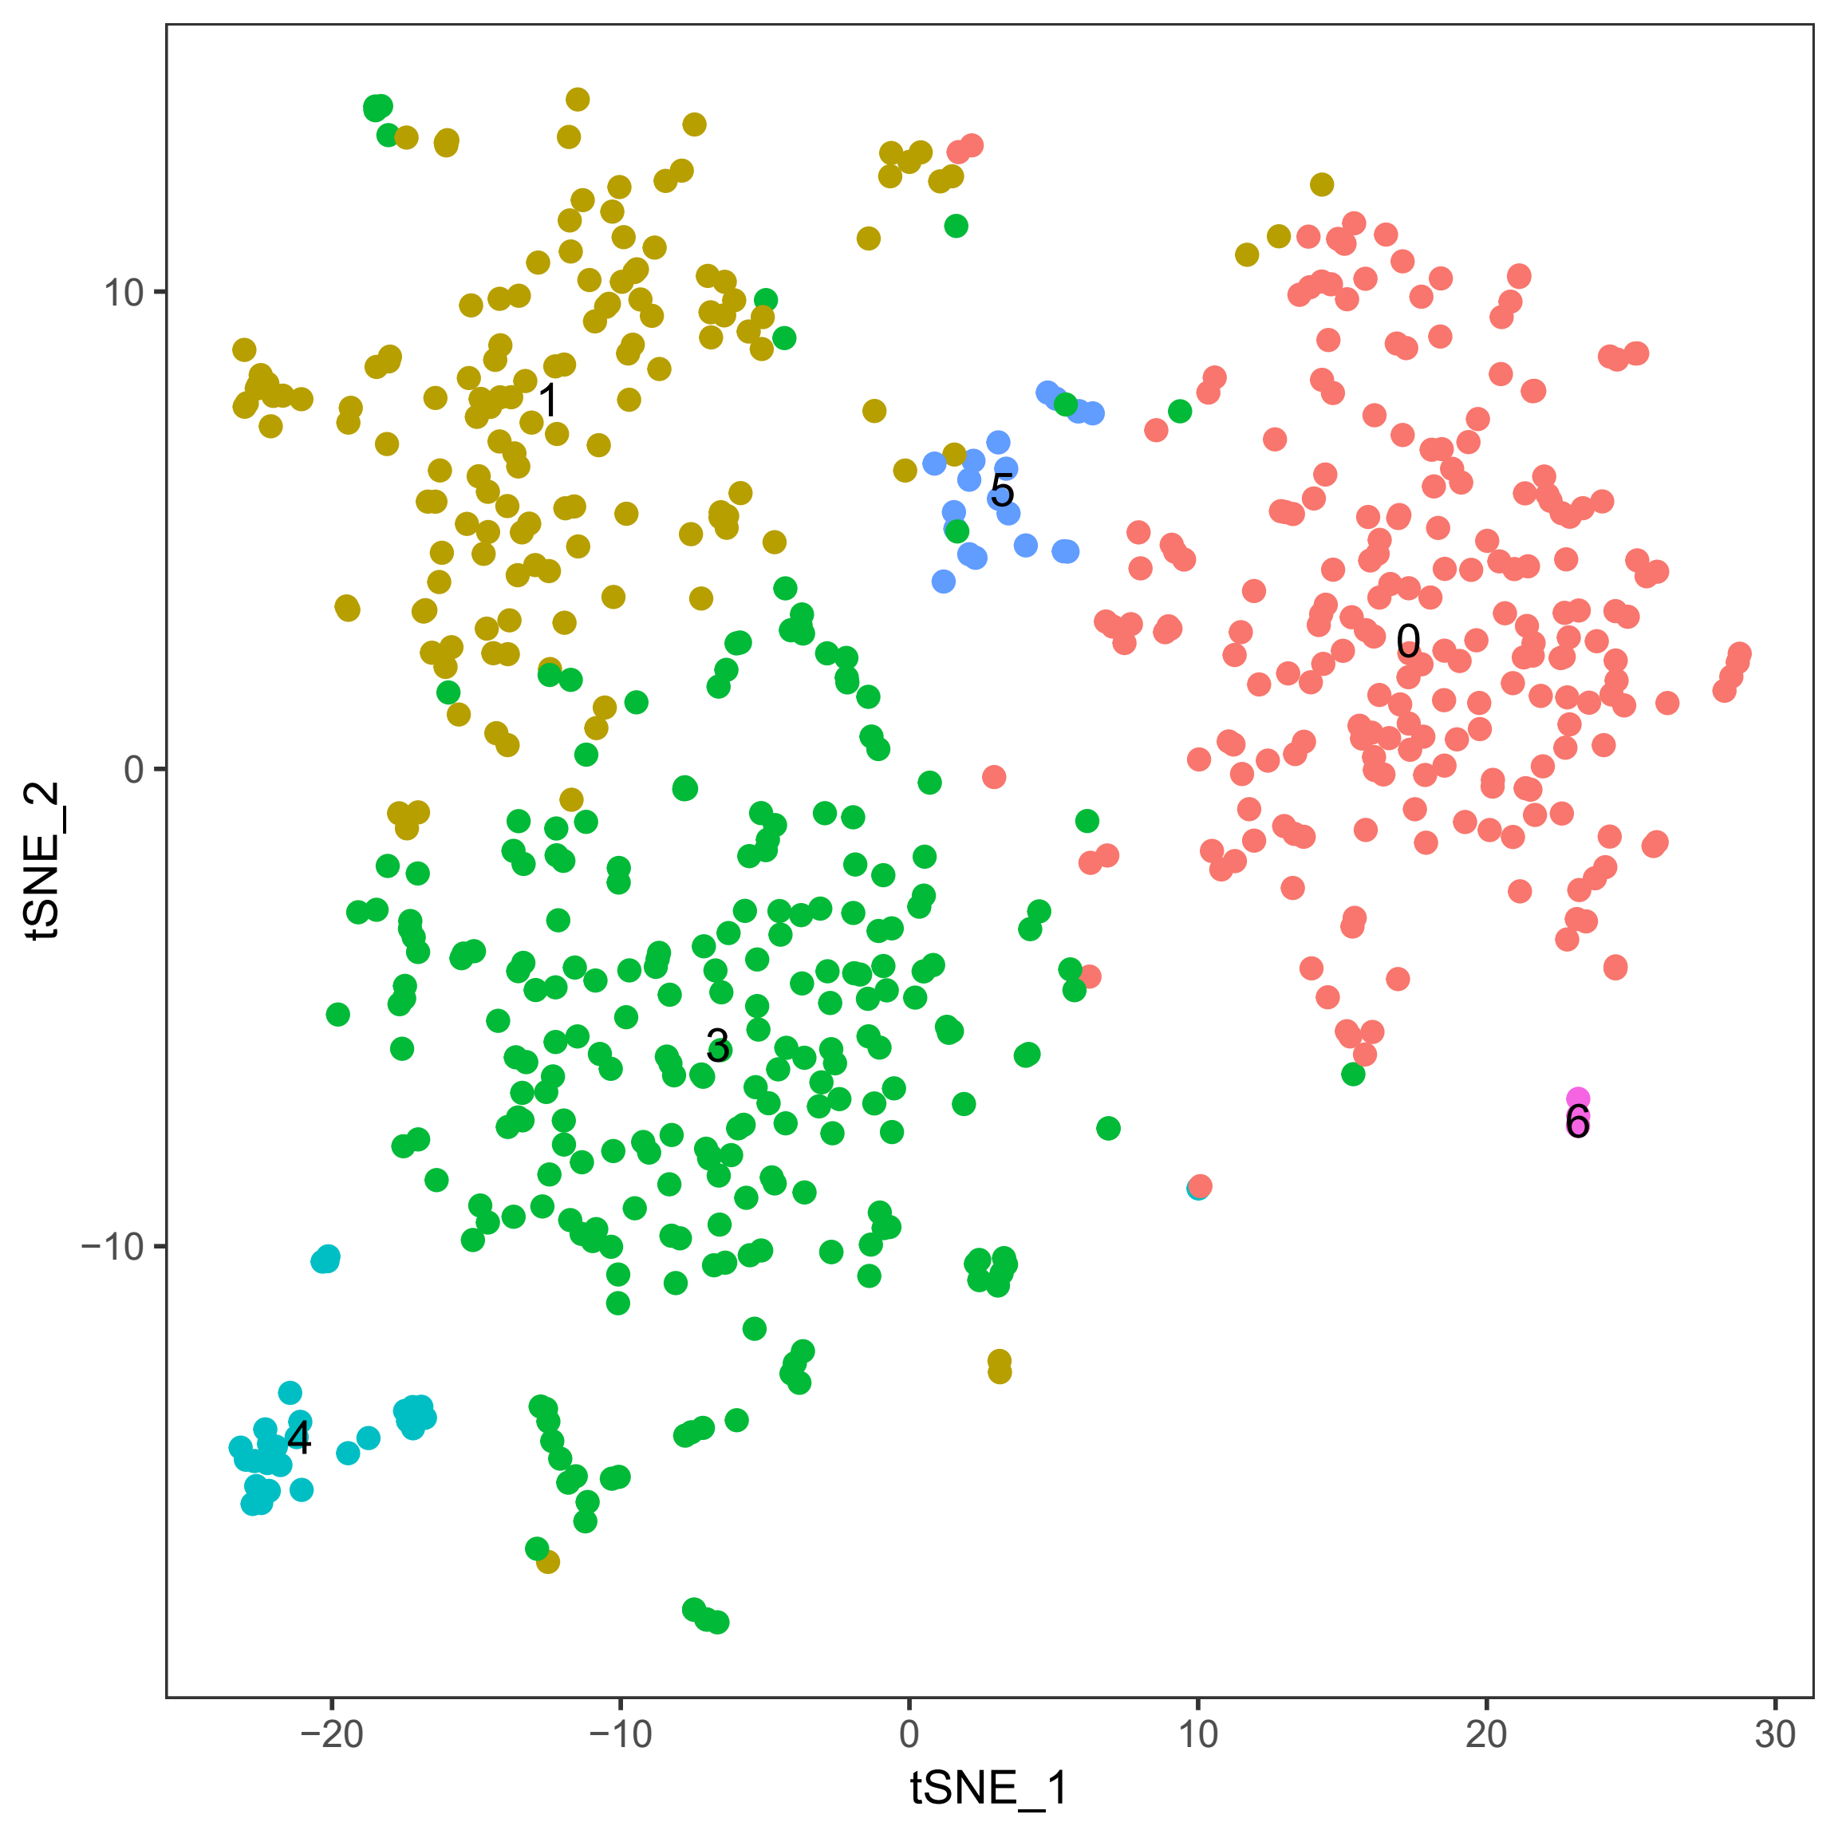
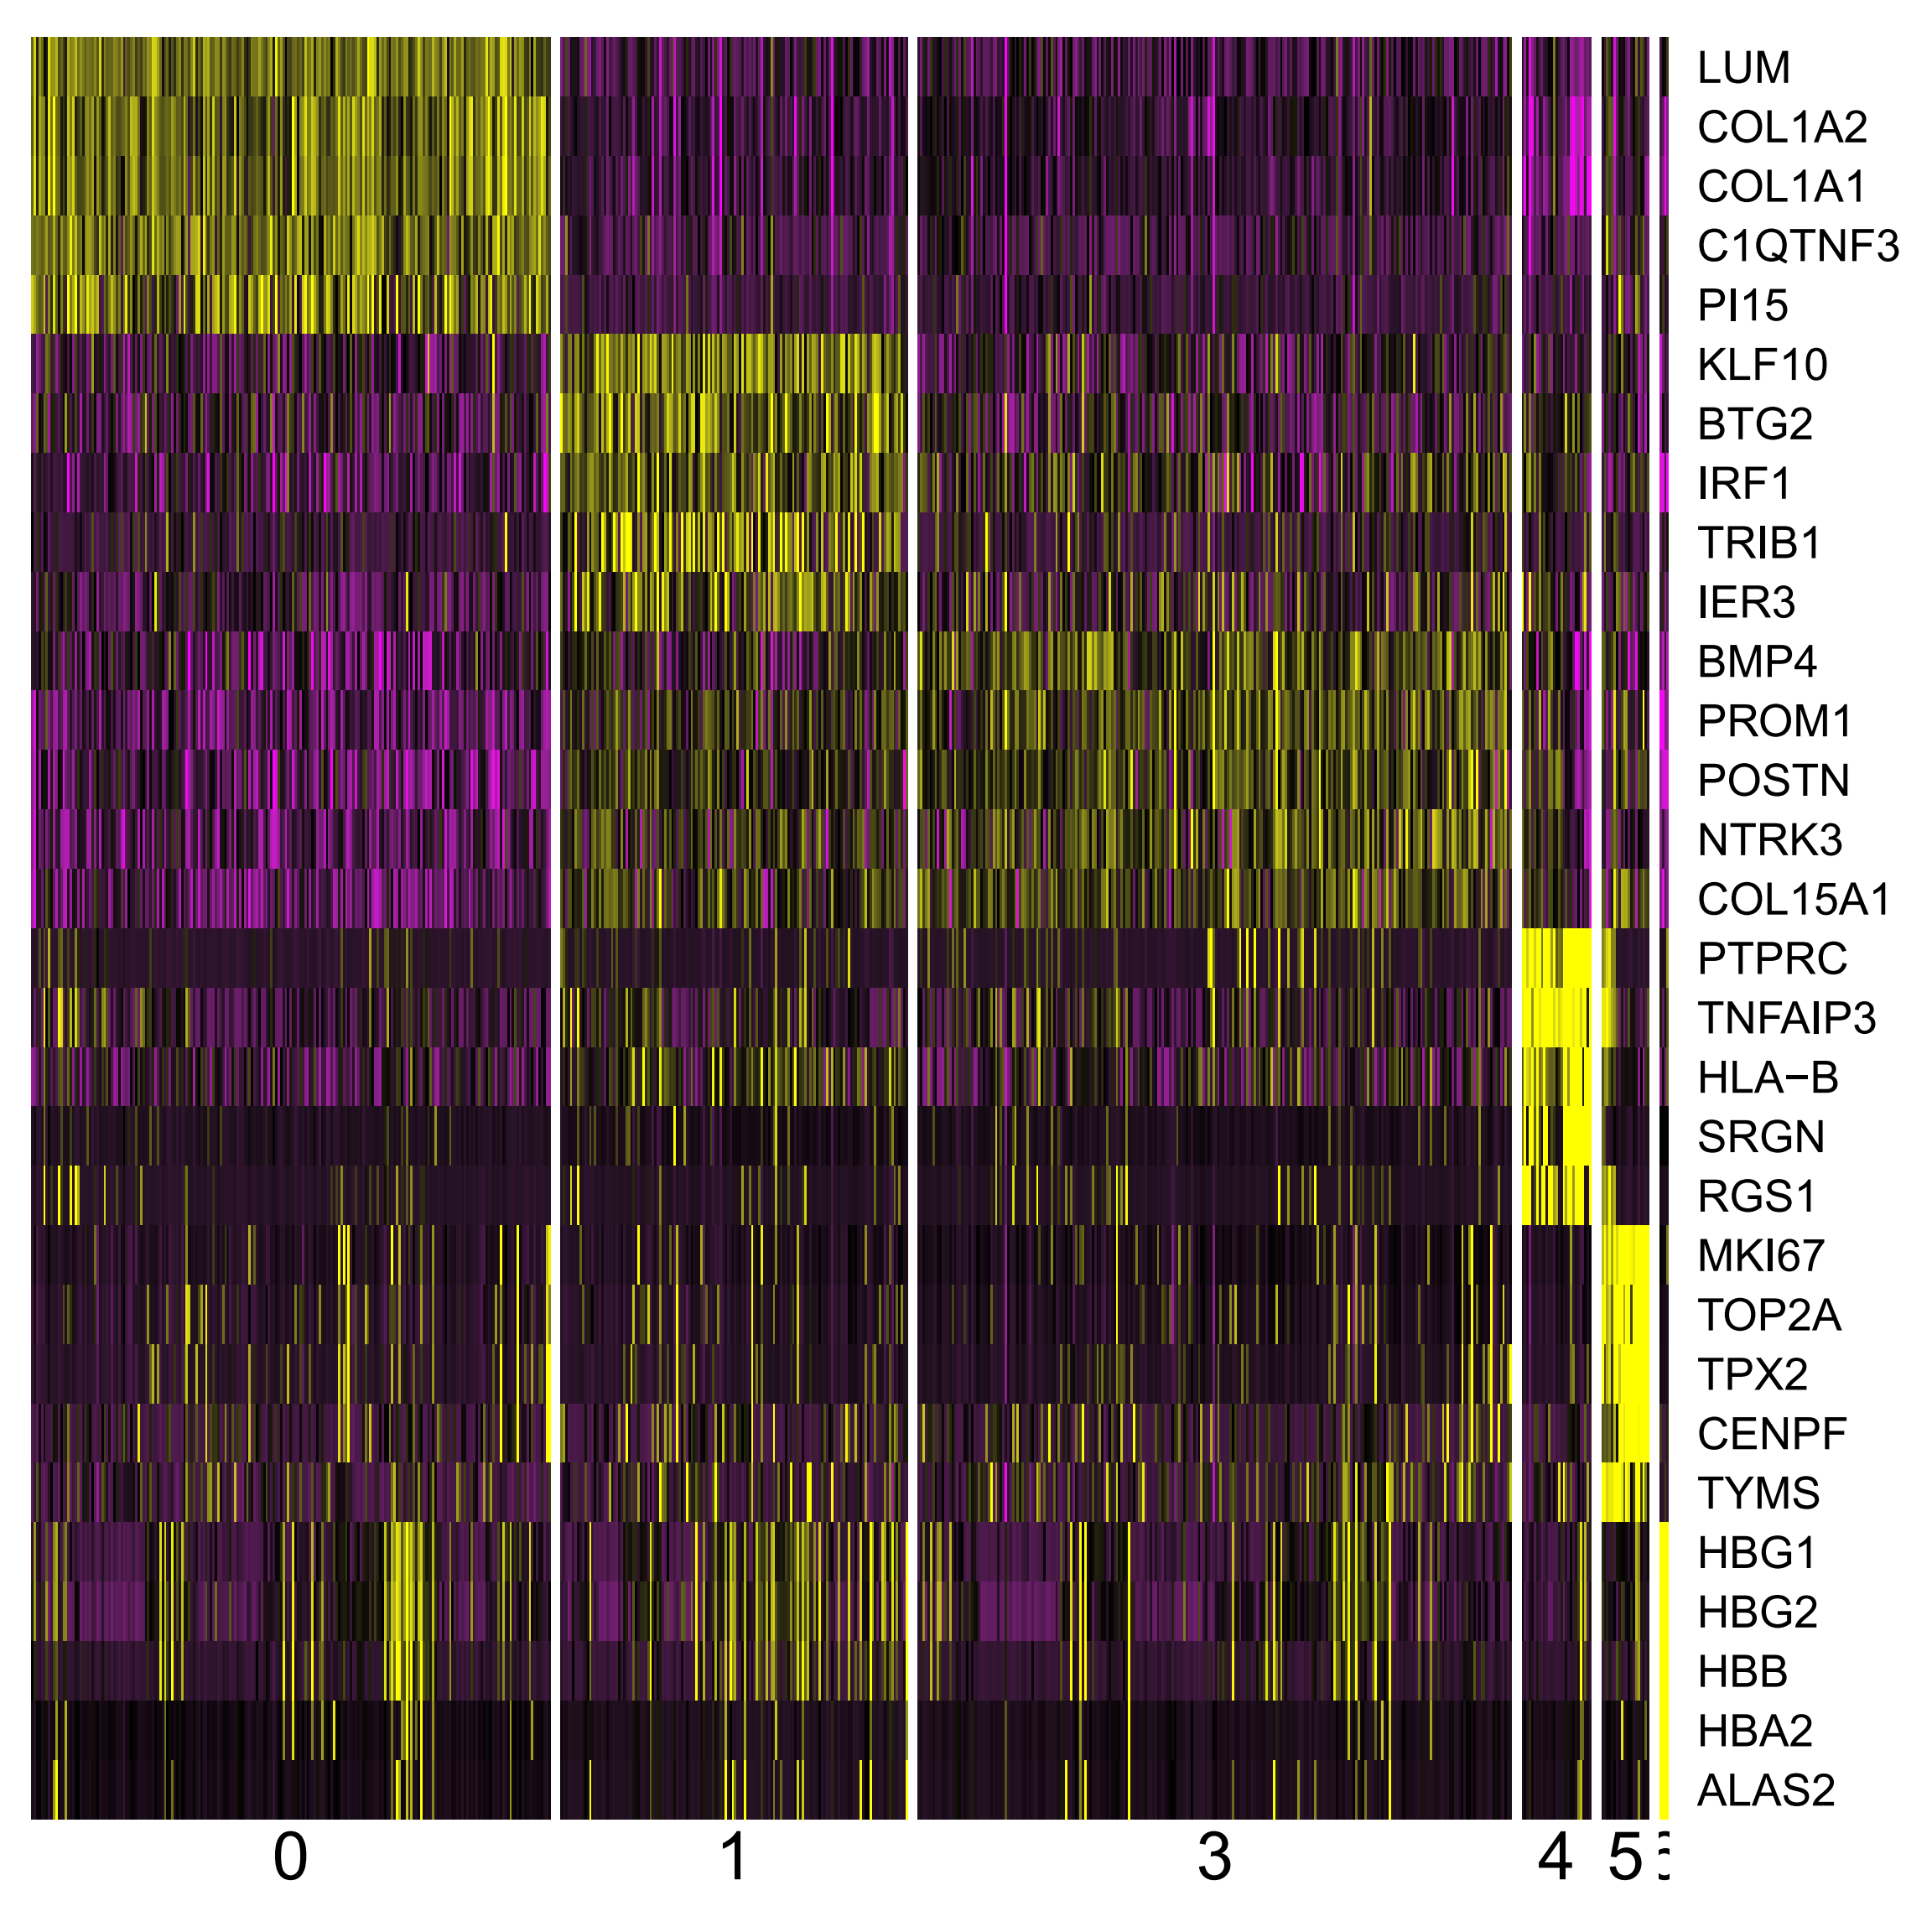
Cell type identification of stomach (fundus)
There are 6 cell types for 658 cells.

Slide 11
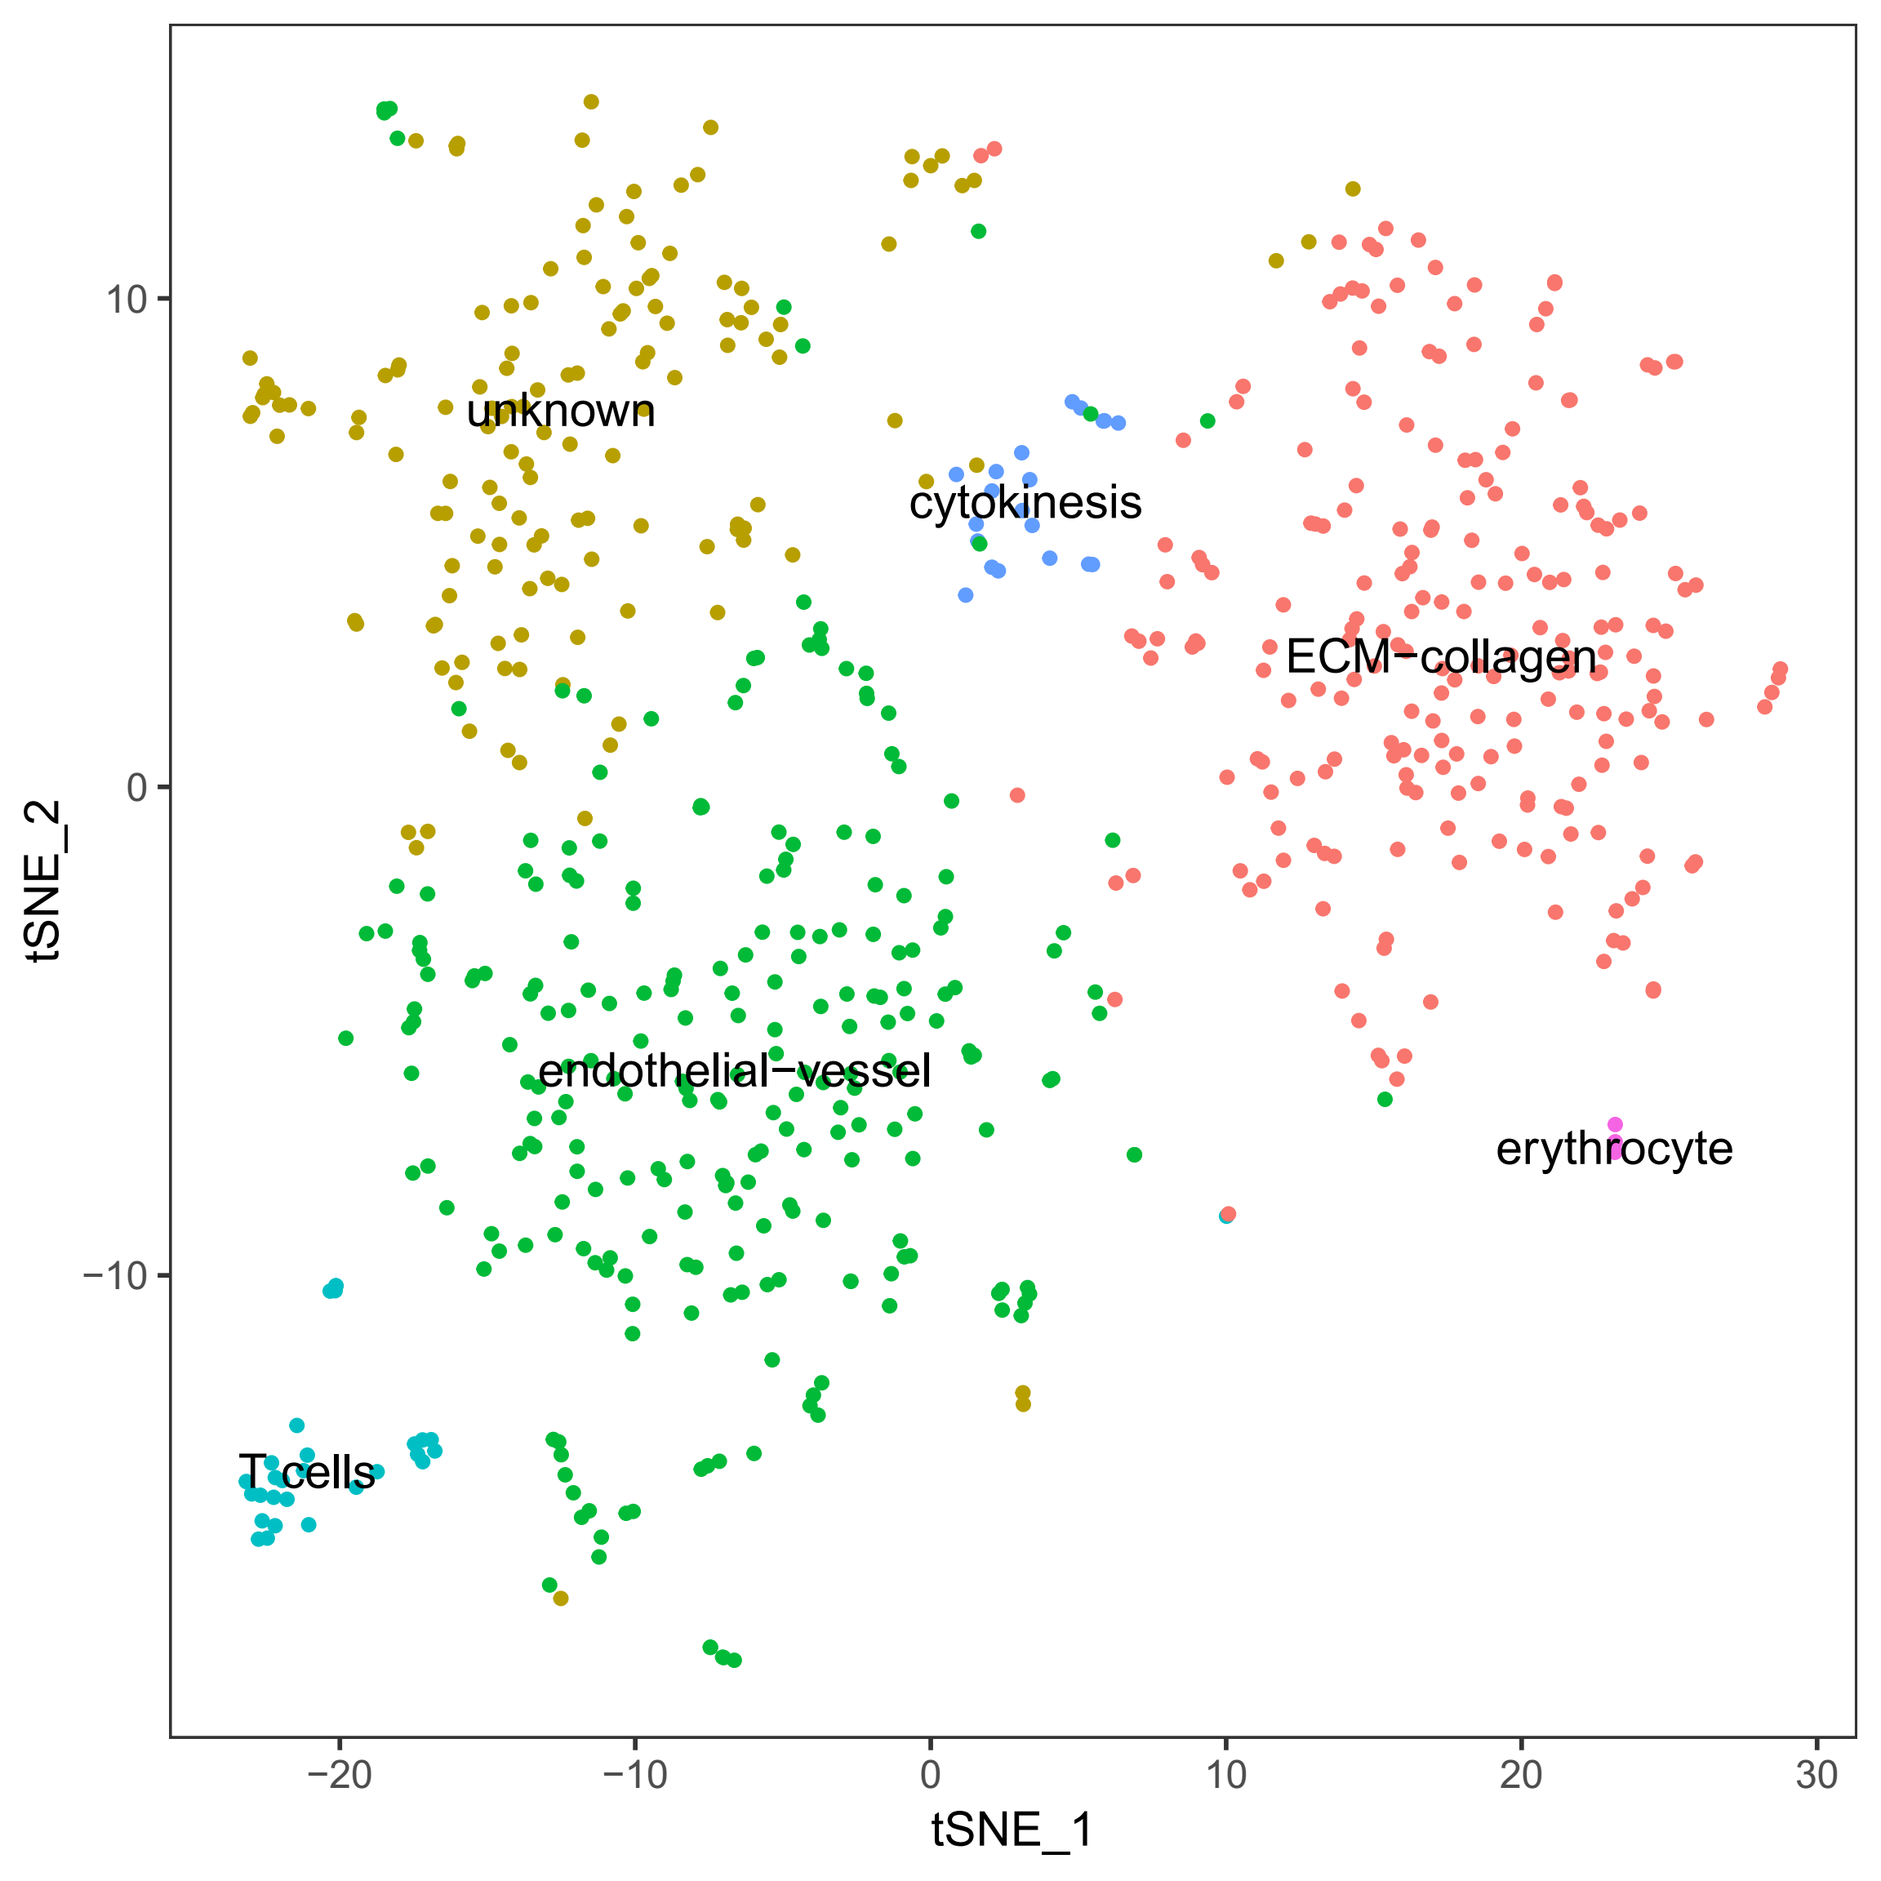
Cell type identification of stomach (fundus)
Annotate cell clusters by marker genes and GO enrichment analysis.

Slide 12
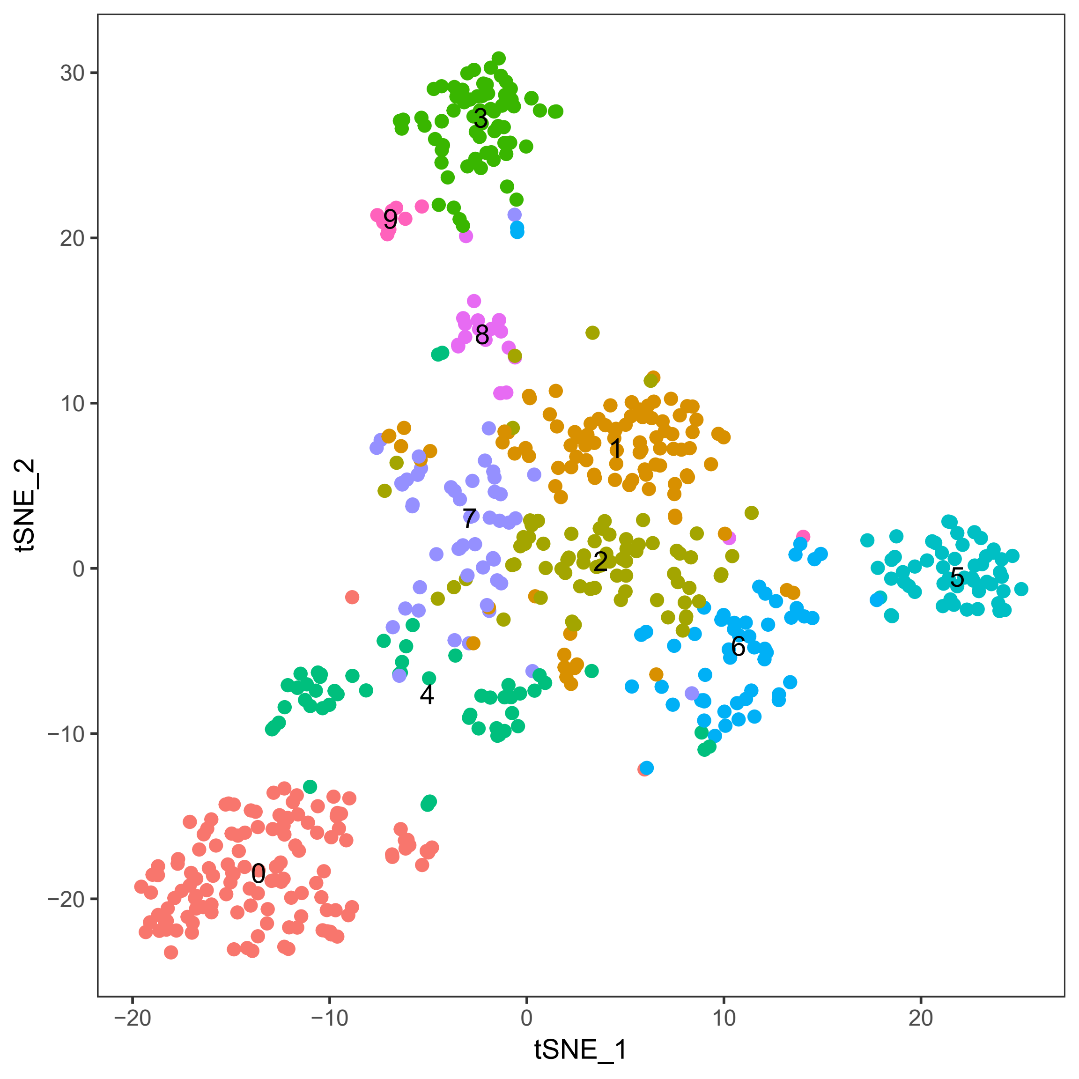
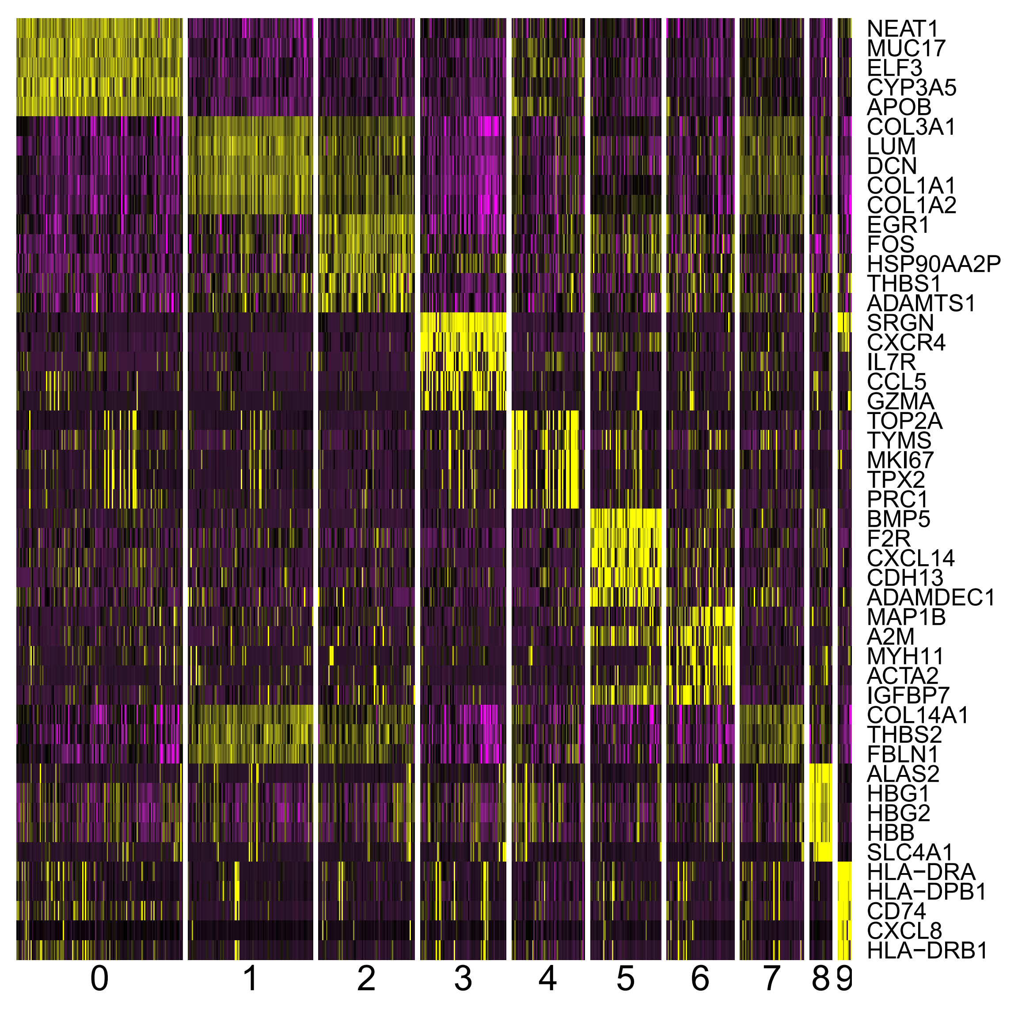
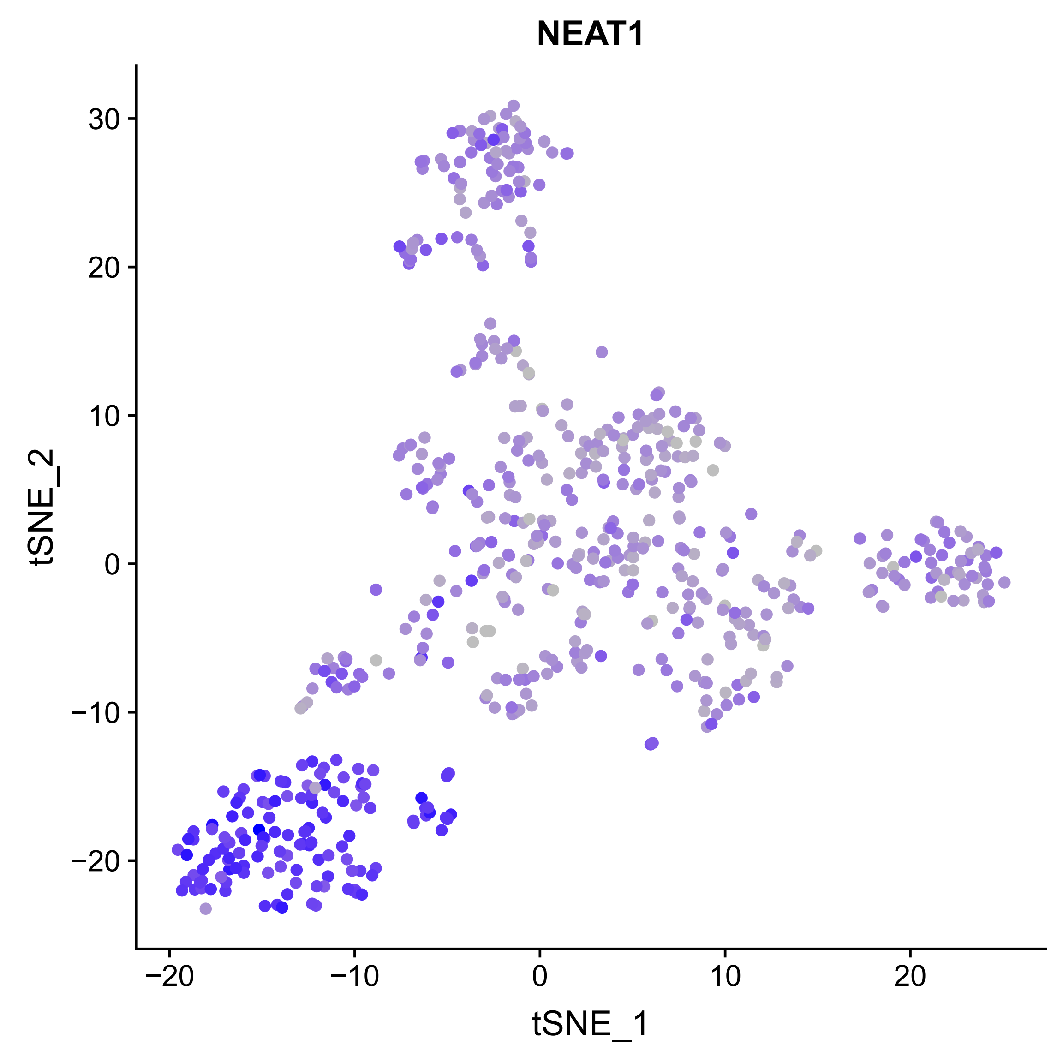
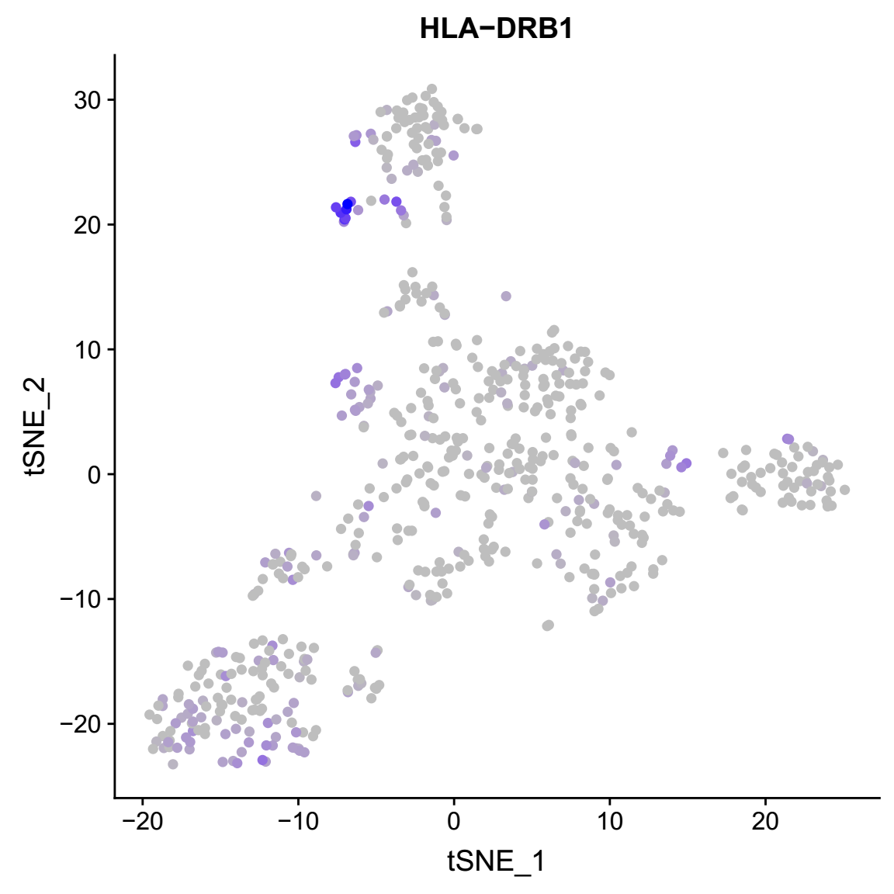
Cell type identification of small intestine (upper)
There are 10 clusters for 612 cells.

Slide 13
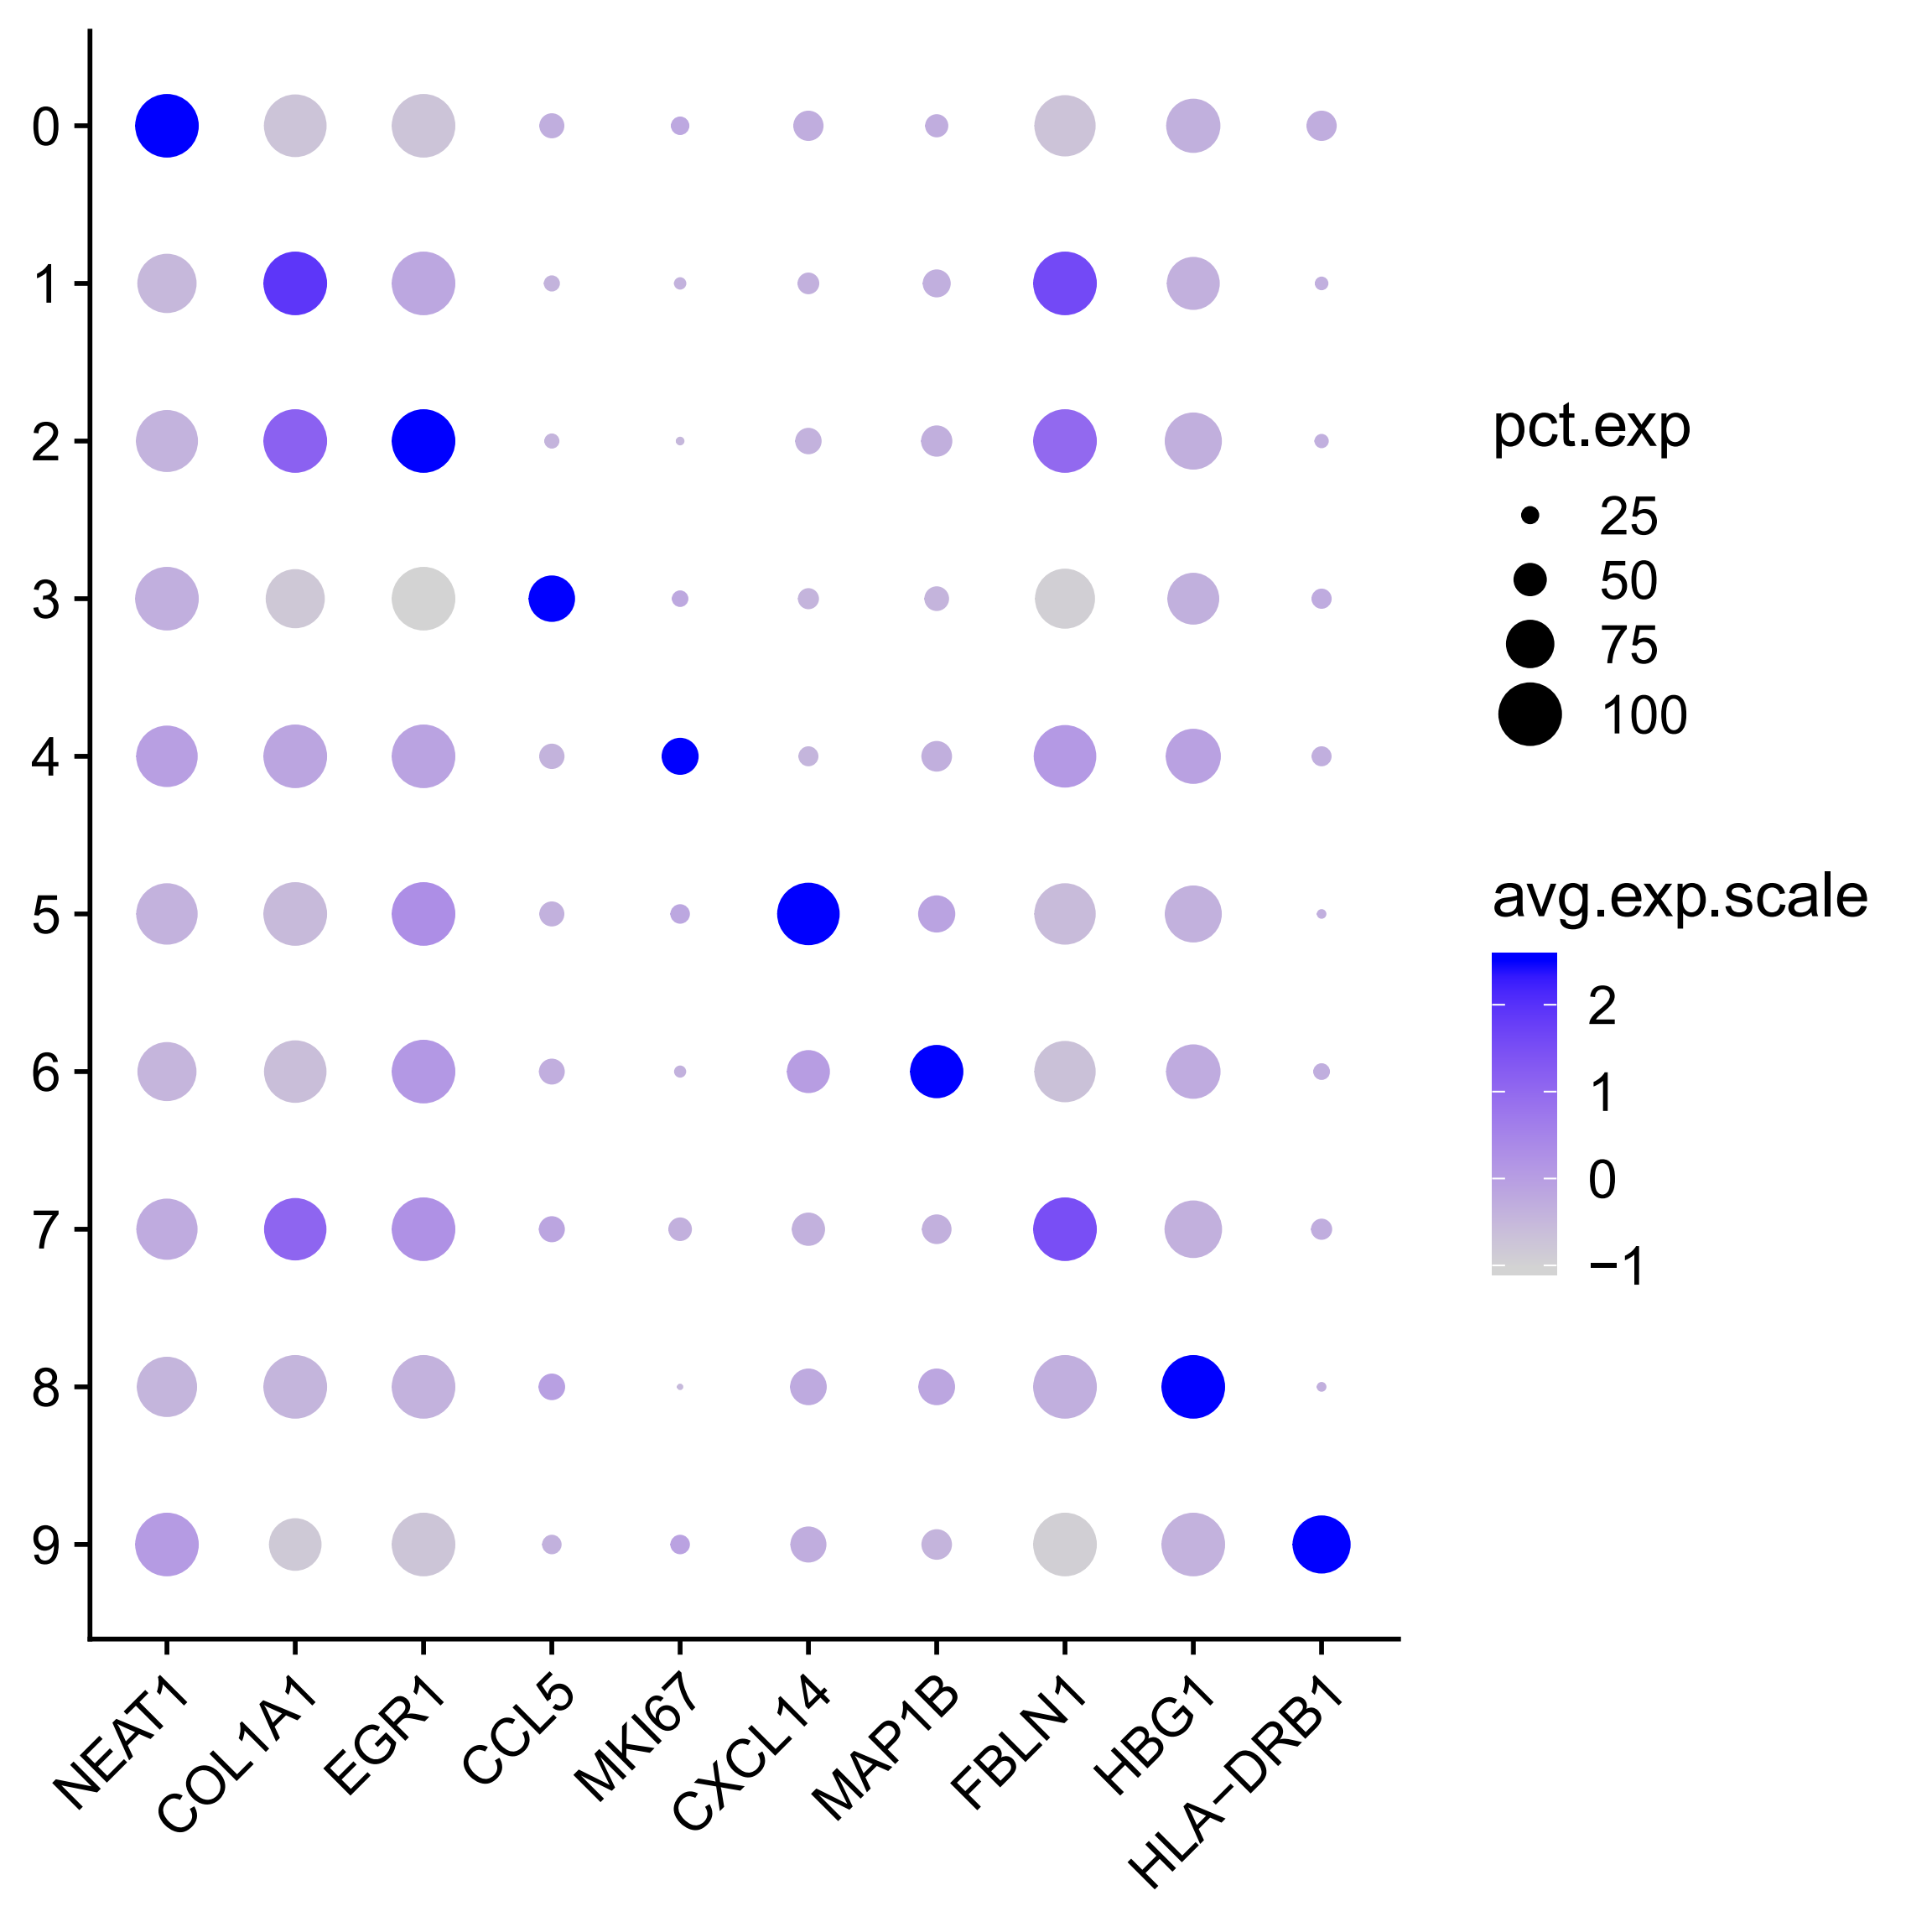
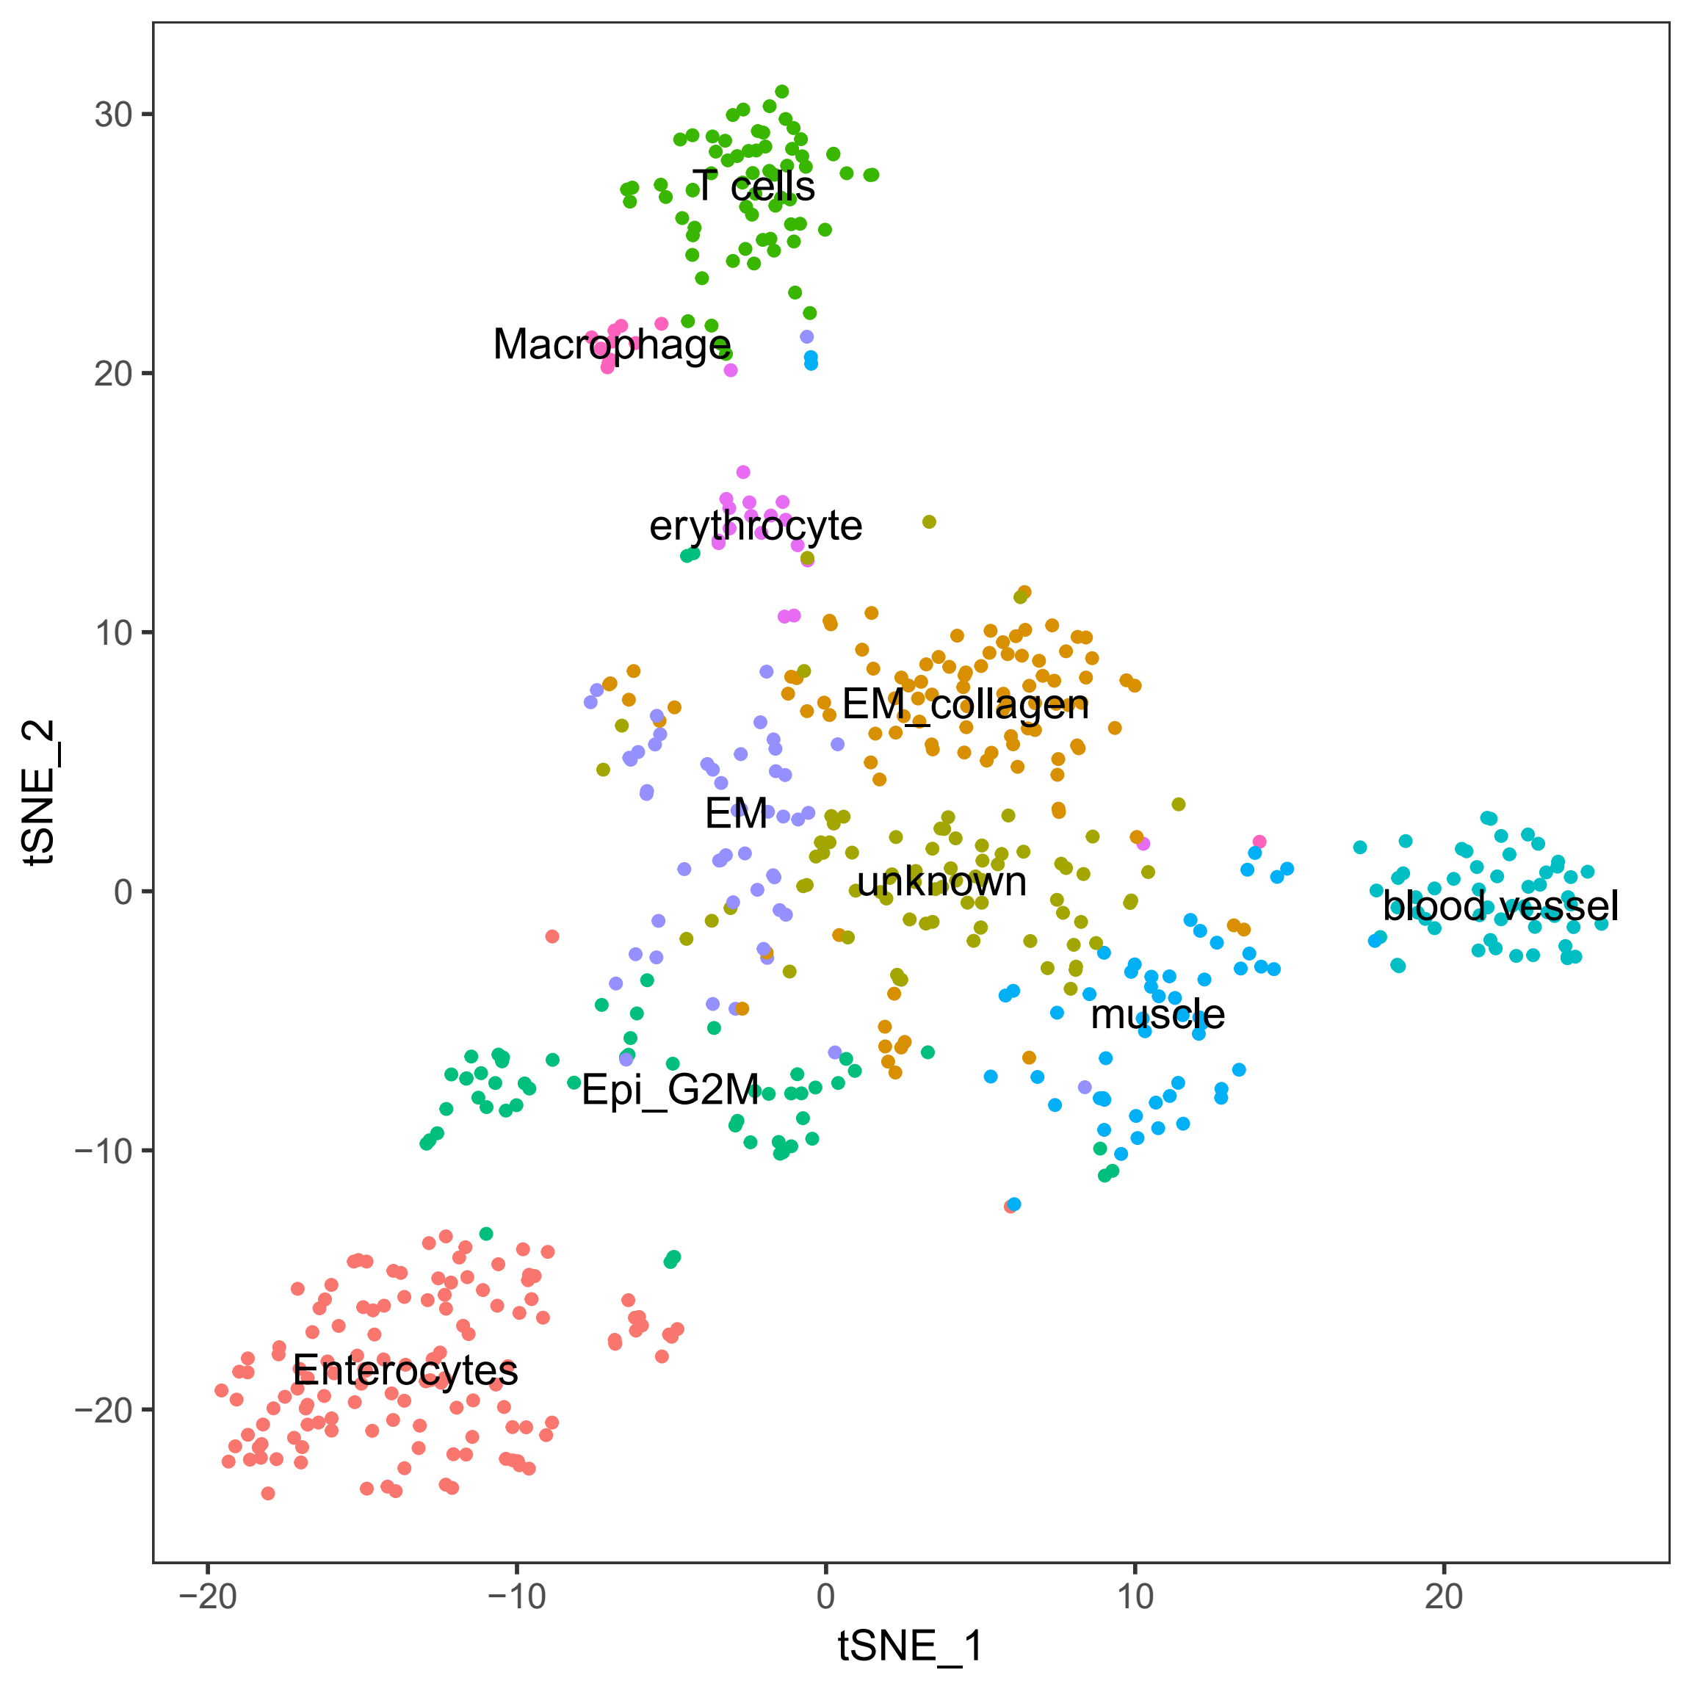
Cell type identification of small intestine (upper)
Annotate cell clusters by marker genes and GO enrichment analysis.

Slide 14
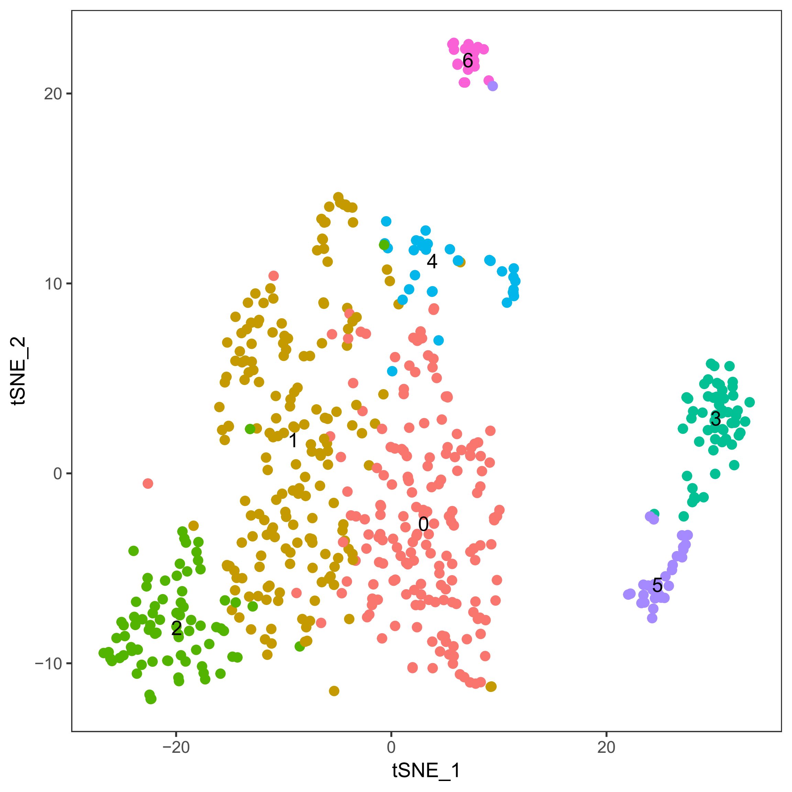
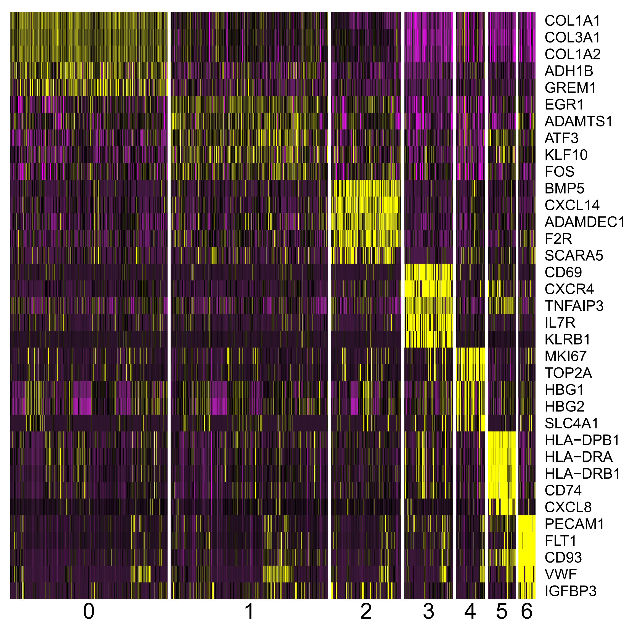
Cell type identification of small intestine (bottom)
There are 7 cell clusters for 576.

Slide 15
Note
Many cells are not Epithelial cells according to the expression level of EPCAM.

Slide 16
Next plan
The difference of the same cell type across different tissues.

Slide 17
Inferring regulatory interactions by differential correlation
TF
TF
Common regulator
Genes in a module
TF
TF
Cell population 1
High TF expression
High correlation
Cell population 2
Low TF expression
Low correlation

Slide 18
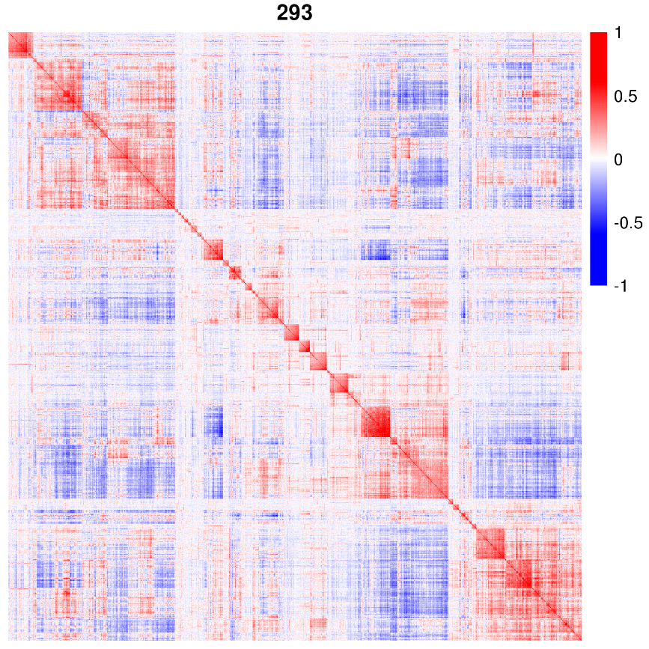
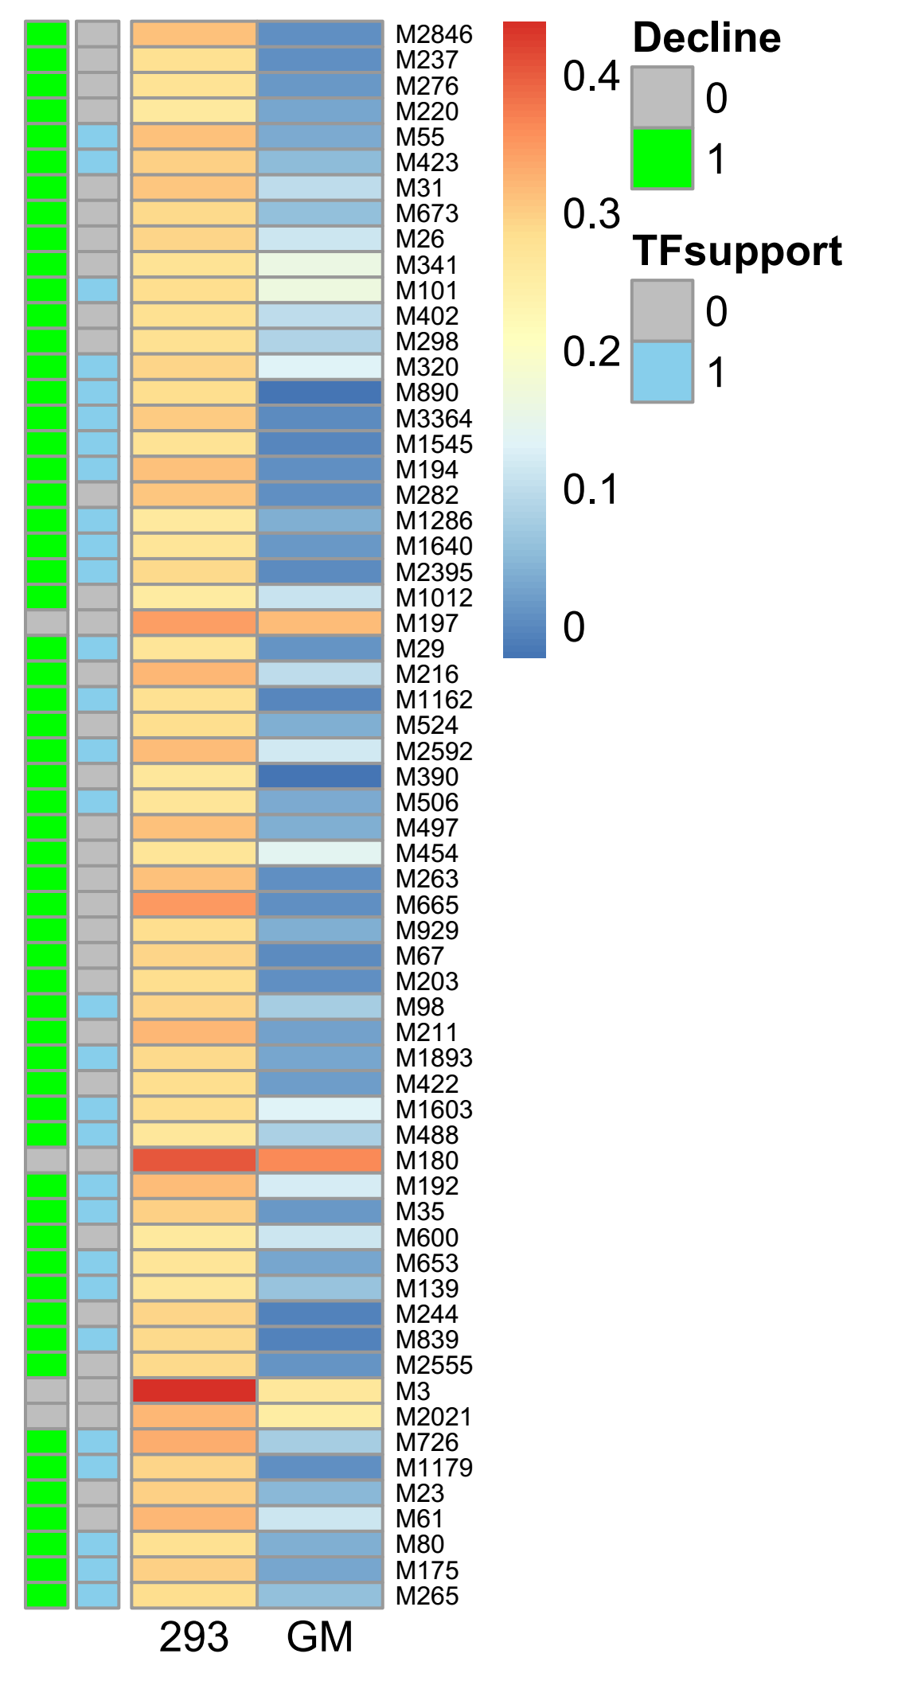
Case study in cell lines
For the 62 modules (HEK293T) with 2,072 genes:
58 modules don’t show high correlation in GM12878 cell line.
30 modules showed at least 1 common TF with decreased expression.

Slide 19
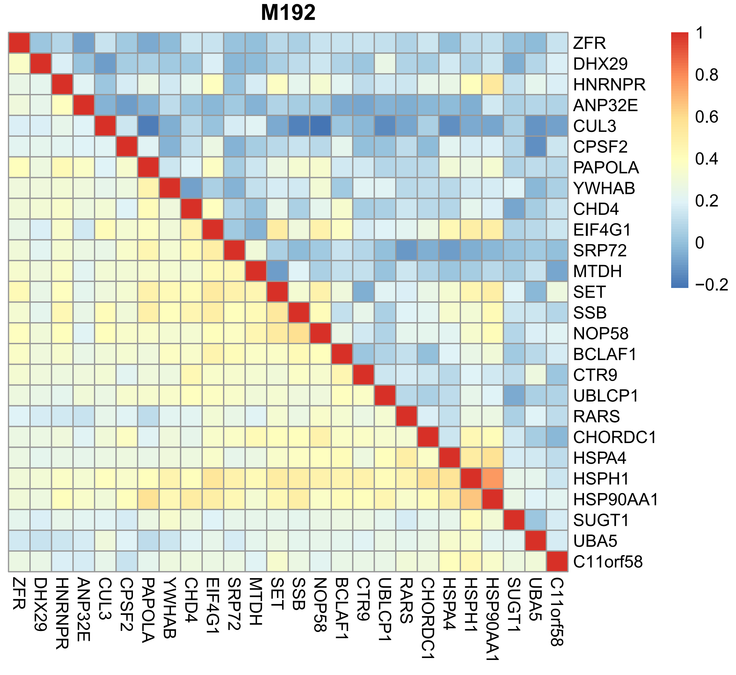
Case study in cell lines

Slide 20
Thanks

